Slide 1
Adaptation plans to climate change in the Adriatic Sea coastal areas -The AdriaClim experience-
CoastPredict and DCC for Coastal Resilience Joint Workshop for Stakeholders and Partners
Integrated Coastal Management and Marine Spatial Planning in support of Coastal Resilience
Andrea Valentini
Bologna January 18, 2023

Slide 2
In coastal area (scale of the Mediterranean Sea and the Adriatic basin) by 2050, according to the Italian National Plan for Adaptation to Climate Change (PNACC 2022), the following effects due to climate change are expected (2021-2050 VS 1981-2010):
surface temperature of the sea will increase between 1 and 2 °C with an increasing of stratification + eutrophic processes → anoxia conditions
The sea level will rise about 7-9 cm, with a possible increase in coastal erosion and exposure to flooding
With the increase in temperature and volume of the sea, there will be an increase in its salinity with an increase in the salinization of aquifers and coastal territories
Adverse effects on the marine ecosystem will be unavoidable
ADAPTATION PLANS and MITIGATION MEASURES
ACCURATE and USABLE INFORMATION at REGIONAL / LOCAL SCALE
There’s a STRONG and URGENT need of

Slide 3
Key Barriers
limited resources
lack of private sector and citizens engagement
insufficient mobilisation of finance
lack of political leadership
low sense of urgency
…the long and complicated authorization process of the Italian legislation
Most of the adaptation options to the key risks depend on limited water and land resources, creating competition and trade-offs also with mitigation options and socio-economic developments.
Closing the adaptation gap requires moving beyond short-term planning and ensuring timely and adequate implementation.
The success of adaptation will depend on our understanding of which adaptation options are feasible and effective in their local context.

Slide 4
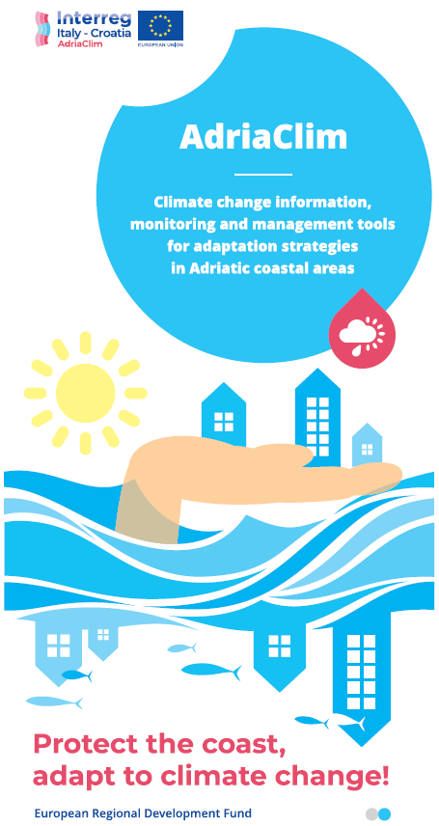
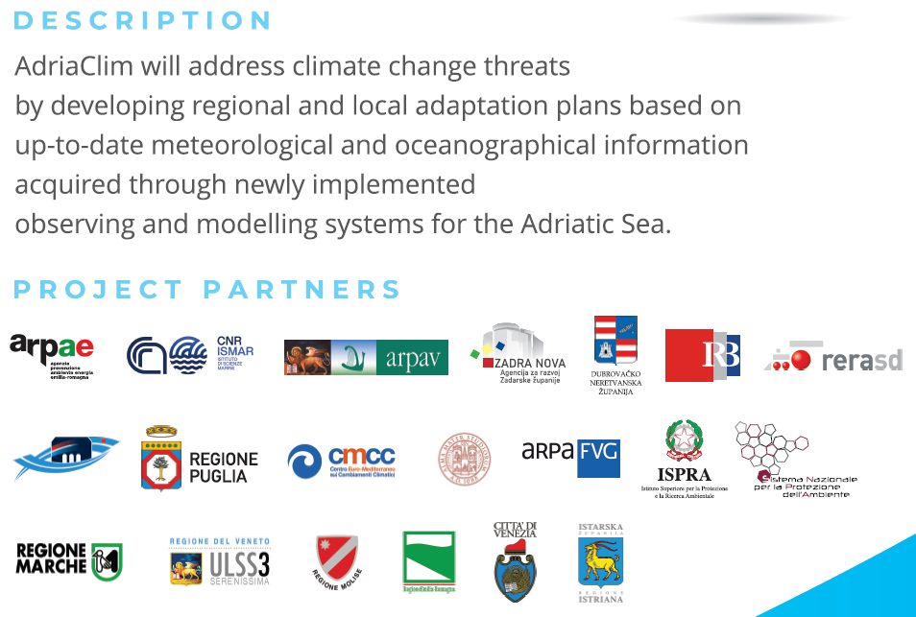
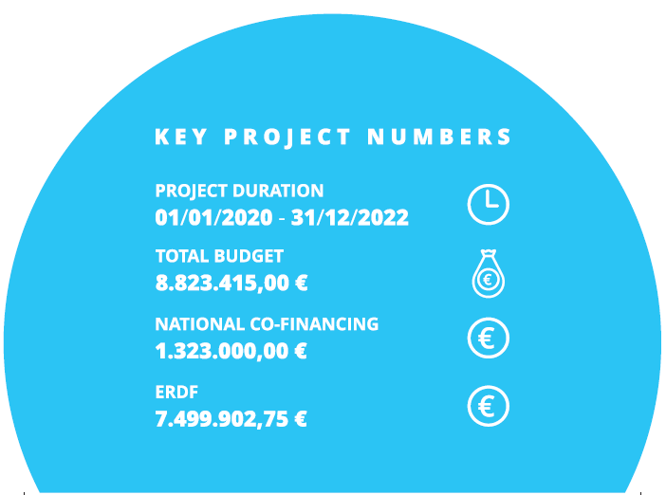
AdriaClim
European strategic project supporting Coastal Adaptation Strategies in Adriatic
19 partners: 14 Italian + 5 Croatian

Slide 5
AdriaClim MAIN OBJECTIVES
Develop accurate information for promoting the development of regional and local plans for adaptation to climate change
Plan a revision of coastal areas for a sustainable blue economy, based on accurate and reliable information
Contribute to fill the gaps in existing observation systems and improve modeling capability by developing integrated high resolution models
Consolidate planning of measures to strengthen adaptation capacity in Italy and Croatia by building cross-border cooperation that continues even after the end of the project

Slide 6
Main knowledge need addressed
Availability and ease of access to databases
Reliable local information, made available both by advanced observation systems and by high-resolution weather-marine forecast chains
New and up-to-dated dataset of climate change indicators, at a regional/local scale
Greater multidisciplinary cooperation
Greater collaboration between researchers and policy makers
Implementation and standardization of participatory processes aimed at achieving optimal citizen involvement in the definition and implementation of adaptation plans
6

Slide 7
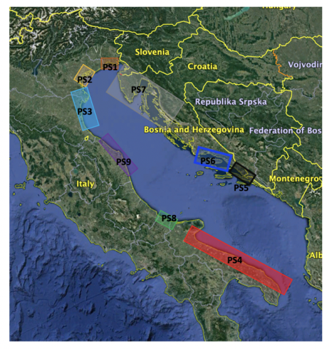
AdriaClim - 9 Adaptation measures Pilots
VENETO
Venice and its Lagoon: contribution to the preparation of the Venice Sustainable Energy and Climate Action Plan (SECAP)
Veneto coast: produce a climate impact and vulnerability assessment and raise awareness among the local stakeholders.
FRIULI-VENEZIA-GIULIA
to generate local scale, very high resolution and integrated information for the future decades to support climate related risks identification and adaptation actions;
to map and to analyze the stakeholder typologies, interest and relevance, with the objective to drive the scientific information towards adaptation actions
to support interested stakeholders groups in adopting the pilot area guidelines and to support them in the definition of specific adaptation actions and plans
EMILIA-ROMAGNA
Adaptation plan of the regional coast of Emilia-Romagna, with stakeholder participatory approach, based on an advanced modelling tool
Formulation of the Strategy on Integrated Management for the Protection and climate change Adaptation of the regional Coast - GIDAC
Reducing vulnerability & risk exposure and enhancing resilience of the coastal system
ZADAR
To ensure on-site water availability and the proper irrigation of small agricultural areas, especially in periods of water deficit (Adaptation Plan and Truck with drinking water)
SPLIT-DALMATIA
Assessment of the microbial food web dynamics and occurrences of the toxic algal blooms in the future climate
MARCHE
Elaboration of an adaptation plan for whole coastal area of the regional territory based on existing data/strategies/guidelines and on WP3-4 outputs
DUBROVNIK NERETVA
Assesment of the salt edge dynamics in the future climate for Neretva River Estuary
Adaptation plan for Slano bay area (Dubrovačko primorje municipality)
MOLISE
Development of the Local Climate Change Adaptation Plan for coastal areas. We will focus on sea level rise and on wildfires as the two most significant Climate Change related effect on the coastal ecosystem
PUGLIA
Implementation of the Adaptation Plan in the Adriatic part of the Region

Slide 8
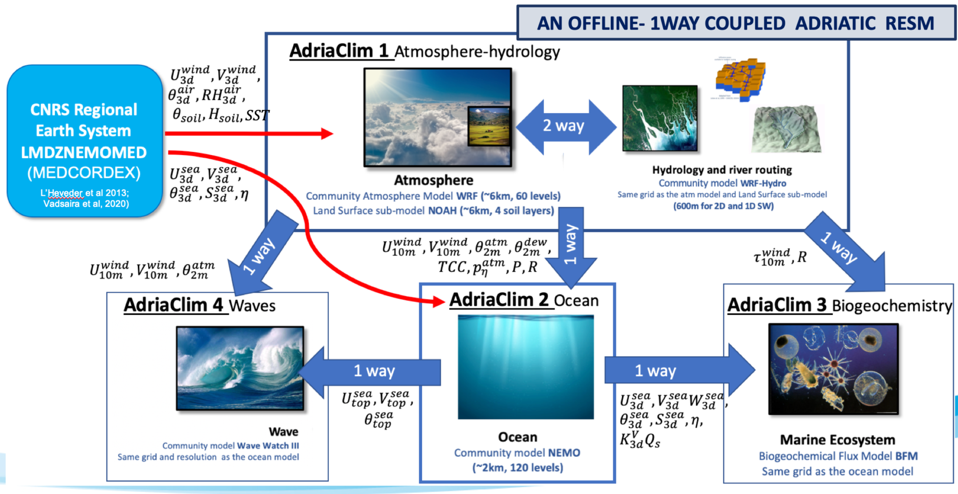
AdriaClim regional to sub-regional scale Climate Downscaling:
AdriaClim Regional Earth System
atmospheric component: LMDZ4-regional (Li et al., 2012)
ocean component: NEMOMED8 (Beuvier et al., 2010; Herrmann et al., 2010)
Land surface and near surface component: ORCHIDEE LSM (Krinner et al., 2005)
🡪 CNRS Med-CORDEX RESM downscaled from the global earth system IPSL-CM5A-MR
By Giorgia Verri et al.

Slide 9
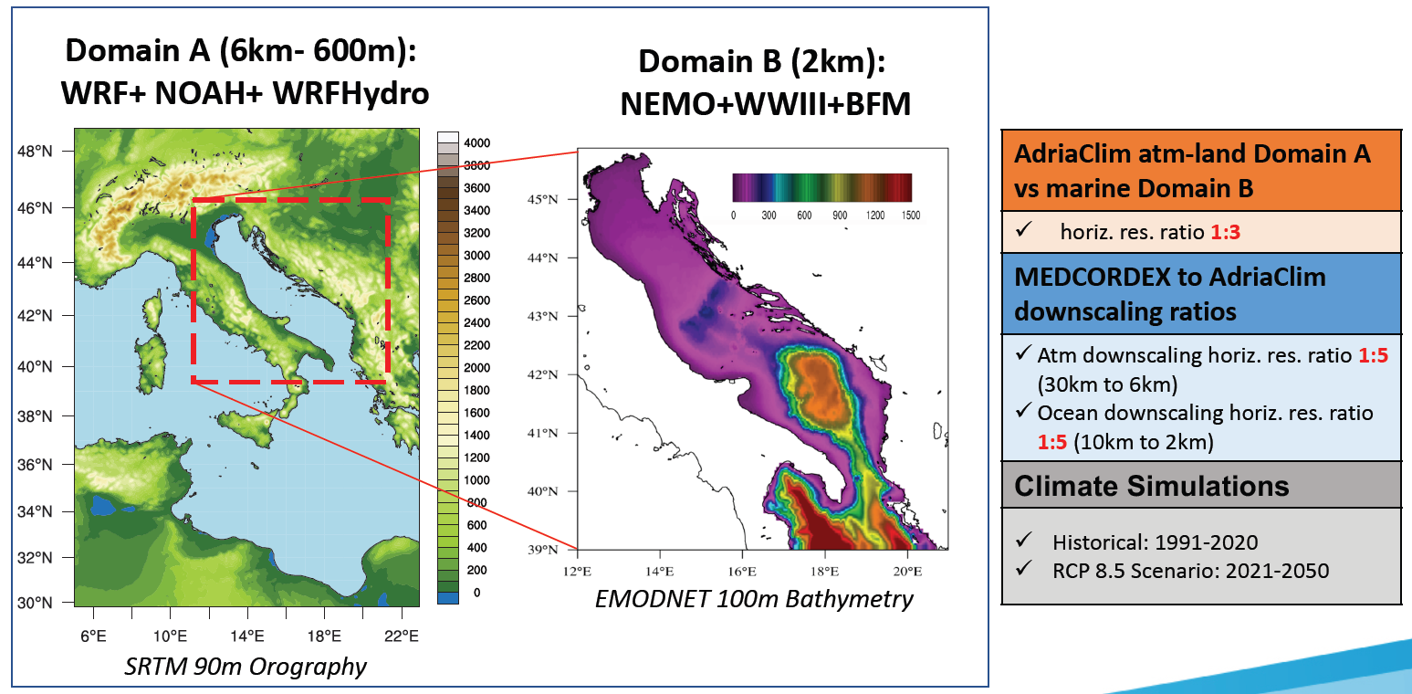
MODELING GOAL: A step forward with respect to the state-of-art of the multi-physics and multi-scale earth system modeling
By Giorgia Verri et al.

Slide 10
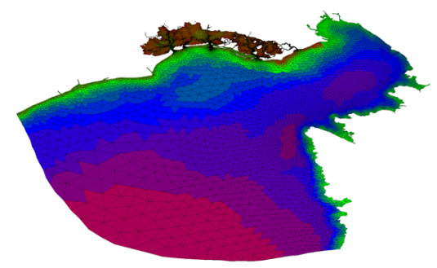
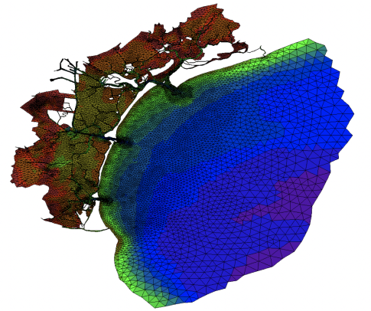
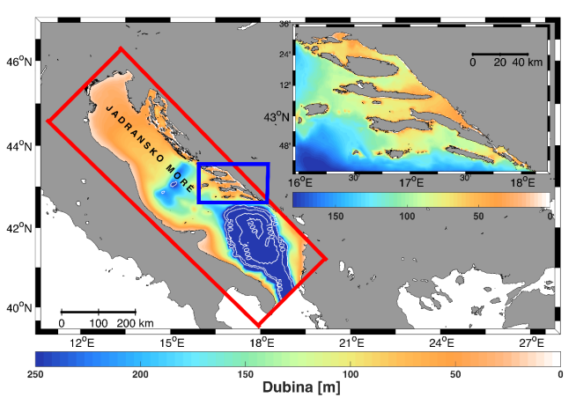
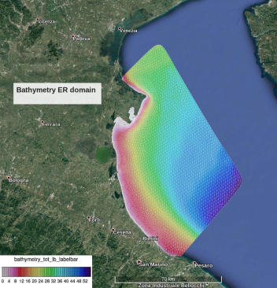
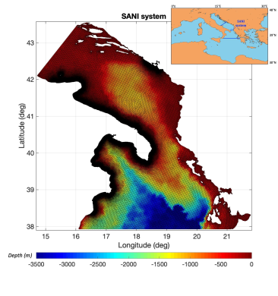
5 modelling
Pilots
Friuli-Venezia Giulia
Veneto
Split-Dalmatia
Emilia-Romagna
Puglia

Slide 11
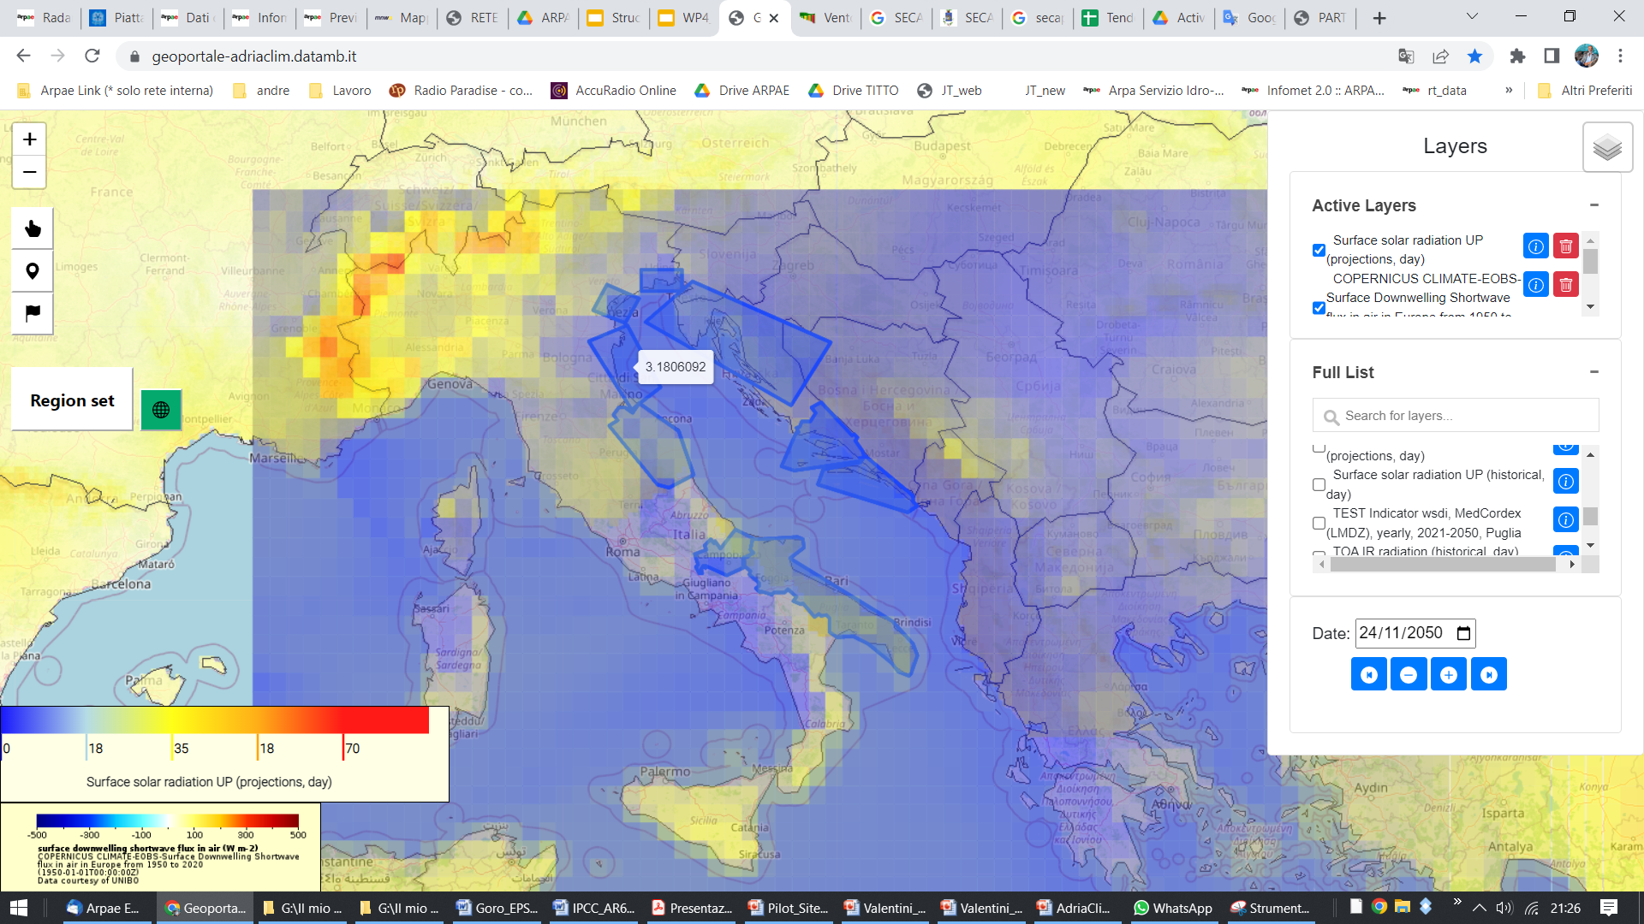
AdriaClim - GEOPORTAL

Slide 12
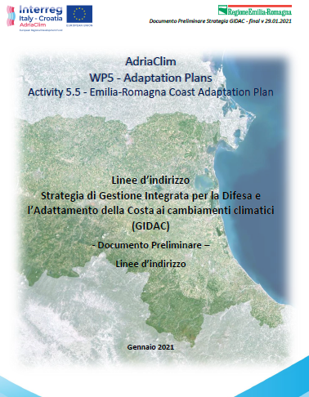
Emilia-Romagna Coastal Adaptation Strategy process
(GIDAC - Integrated Management for the Protection and Adaptation of the Coast to Climate Change)
We’re here
✓
✓
✓
✓
✓
✓
Start Activities
AdriaClim
06/2020
Participation Team constitution
Design Participatory Process
Launching INFODAY
23/04
Restitution
Workshop Draft Strategy
16/11
Public consultation
5/04-31/05
Detailed scenarios
Strategy
tuning-up
Final Document
GIDAC
🡪
2020
2021
2022
2023
✓
✓
✓
✓
Regional Working Group constitution
Draft Preliminary Document
Preliminary Document
Guidelines for the Strategy
6 Participated
Laboratories
May 2021
Detailed scenarios on ER coast
INFODAY
Strategy Presentation
🡪
🡪
By Roberto Montanari RER

Slide 13
www.italy-croatia.eu/web/adriaclim/
www.facebook.com/AdriaClim-Project-Interreg-ITA-CRO-101403105233732
www.youtube.com/channel/UCz1icHMIWGzxBfJ-Ida-ABQ/featured
www.twitter.com/adriaclim
AdriaClim LP
adriaclim-arpae@arpae.it
Viale Silvani, 6 – 40122 Bologna (Italy)
https://www.arpae.it/sim/

