Slide 1

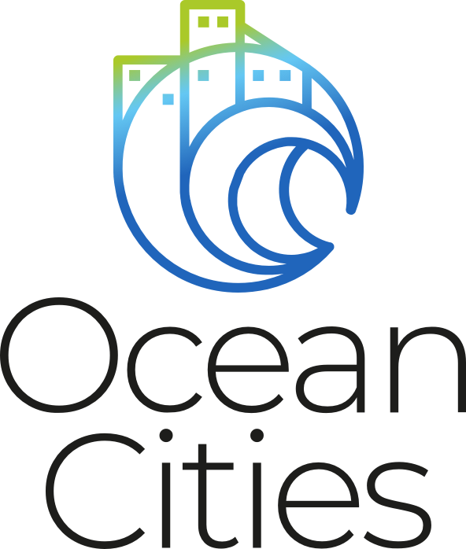

Ocean Cities an international network of cities in harmony with the marine environment
Vanessa Sarah Salvo
Institut de Ciències del Mar (ICM)
Spanish National Research Council (CSIC)
Integrated Coastal Management and Marine Spatial Planning in support of Coastal Resilience
UN Decade Collaborative Centre for Coastal Resilience - University of Bologna - Workshop – January 18, 2023

Slide 2

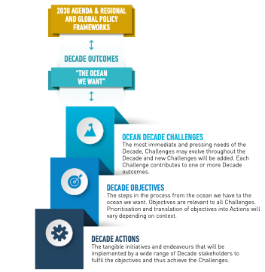
OD Framework
OD Tools
OD endorsed Programme
Ocean Cities Network is a 10 years Programme of an international network of coastal cities that promotes bottom‐up collaboration of citizen and stakeholders to build up an effective dialogue towards science-based policies.
Programmes
Projects
Activities
Contributions

Slide 3

Global
Goals 2030
Regional
Oceans Cooperation
Science-based policy
Local
Research institutions
Local Governance
Civil Society

Slide 4
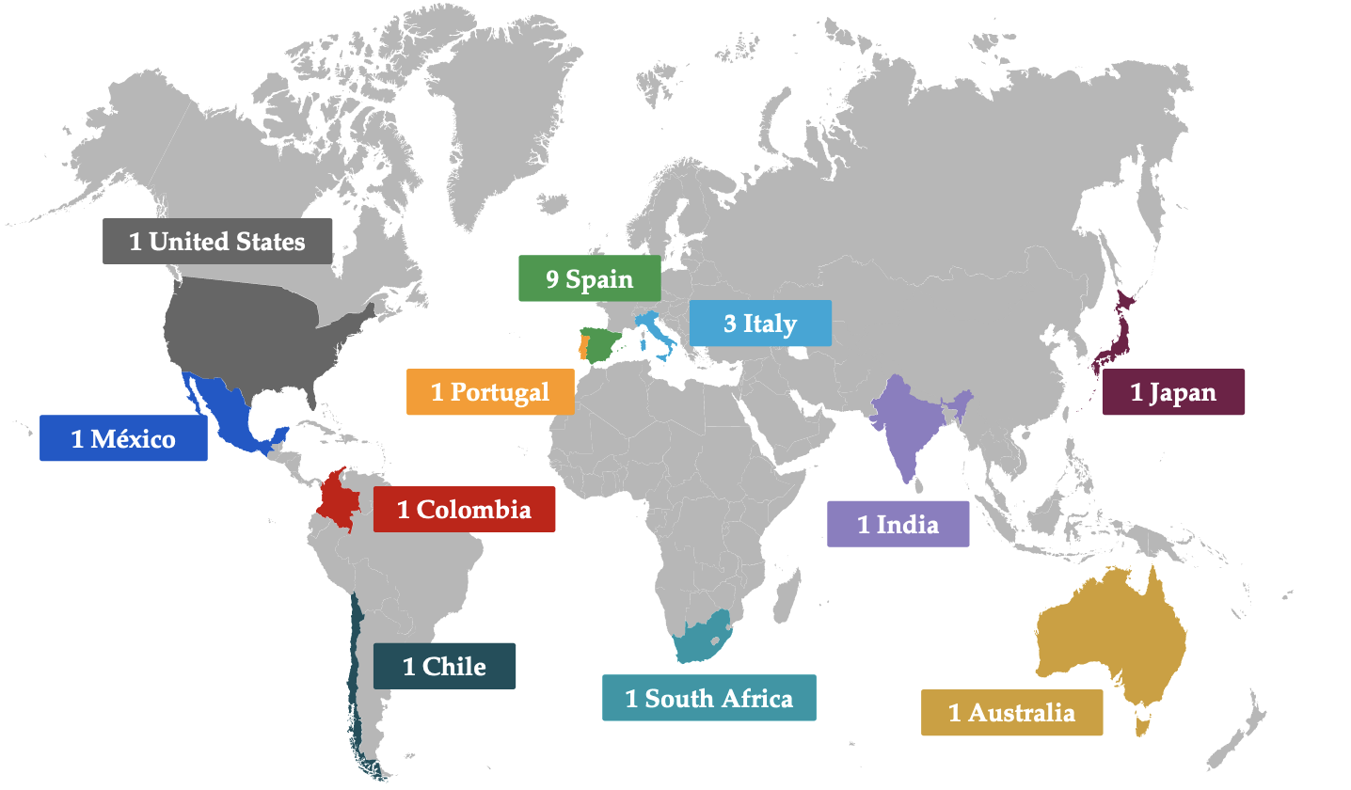
Partners
Centro de Investigación Científica y de Educación Superior de Ensenada (CiCESE, MX)
Centro de Investigaciones del Mar y de la Atmosfera Instituto Franco Argentino para el estudio del Clima y sus Impactos (CIMA, AR)
Oceans & Atmosphere Univerisity of Queesland (CSIRO, AU)
Universidad de Concepción (CL)
Instituto de Investigaciones Marinas y Costeras (INVEMAR, CO)
Universidad de Antioquia (CO)
Universidad de las Palmas de Gran Canaria (ULPGC, ES)
Marine and Environmental Science Centre University of Coimbra (MARE,PT)
University of Cape Town (MARIS, ZA)
National Institute of Oceanography Council of Scientifiic & Industrial Research (CSIR, INDIA)
Università degli studi di Genova (UNIGE, IT)
Università Politecnica delle Marche (UNIVPM, IT)
Tokyo University of Marine Science and Tecnology (TUMSAT, JP)
Barcelona Local Council
MedCities
C40 CITIES
Coordinators
Alliance
Institut de Ciènces del Mar (ICM-CSIC, ES)
Unitat de Tecnologia Marina (UTM-CSIC, ES)
Bau Design College (BAU, ES)
ECSA European Citizen Science Association
INGENIO CSIC- UPV (ES)
La Fura dels Baus (ES)
Stazione Zoologica Anton Dohrn (SNZ, IT)
SEA-EU Thee European University of the Sea

Slide 5
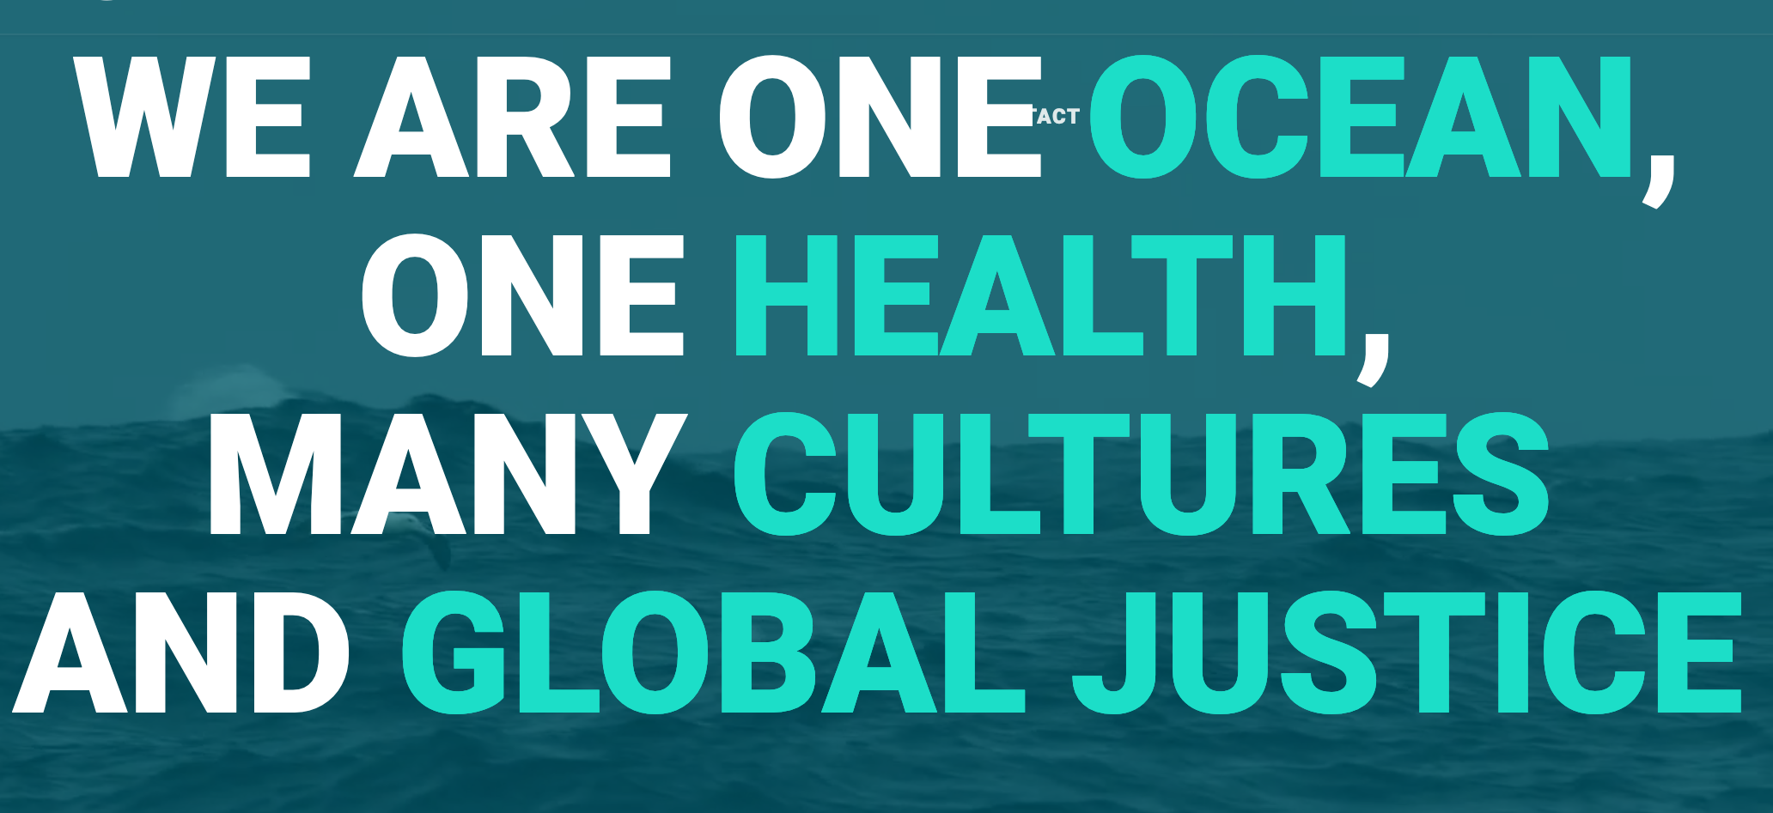
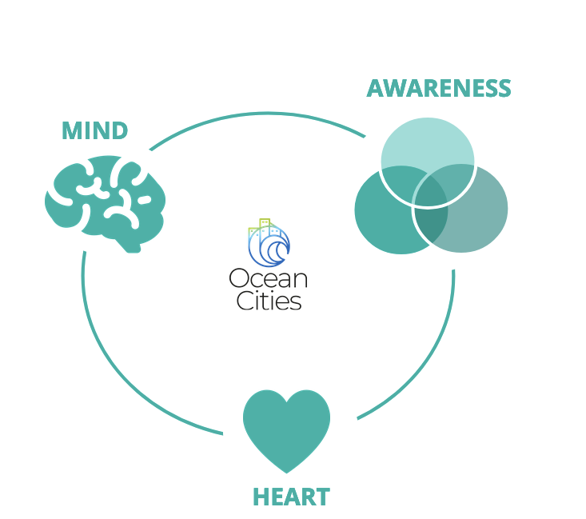
Working Areas & Research Axis
HEALTH
Monitoring Resilience
Fostering initiatives under the global health approach
CULTURE
Perception Connection
Ocean literacy, traditional ecological knowledge and territorial linkage
JUSTICE
Sharing Interrelations
Inclusive transformative ocean science and fair transition to sustainability

Slide 6
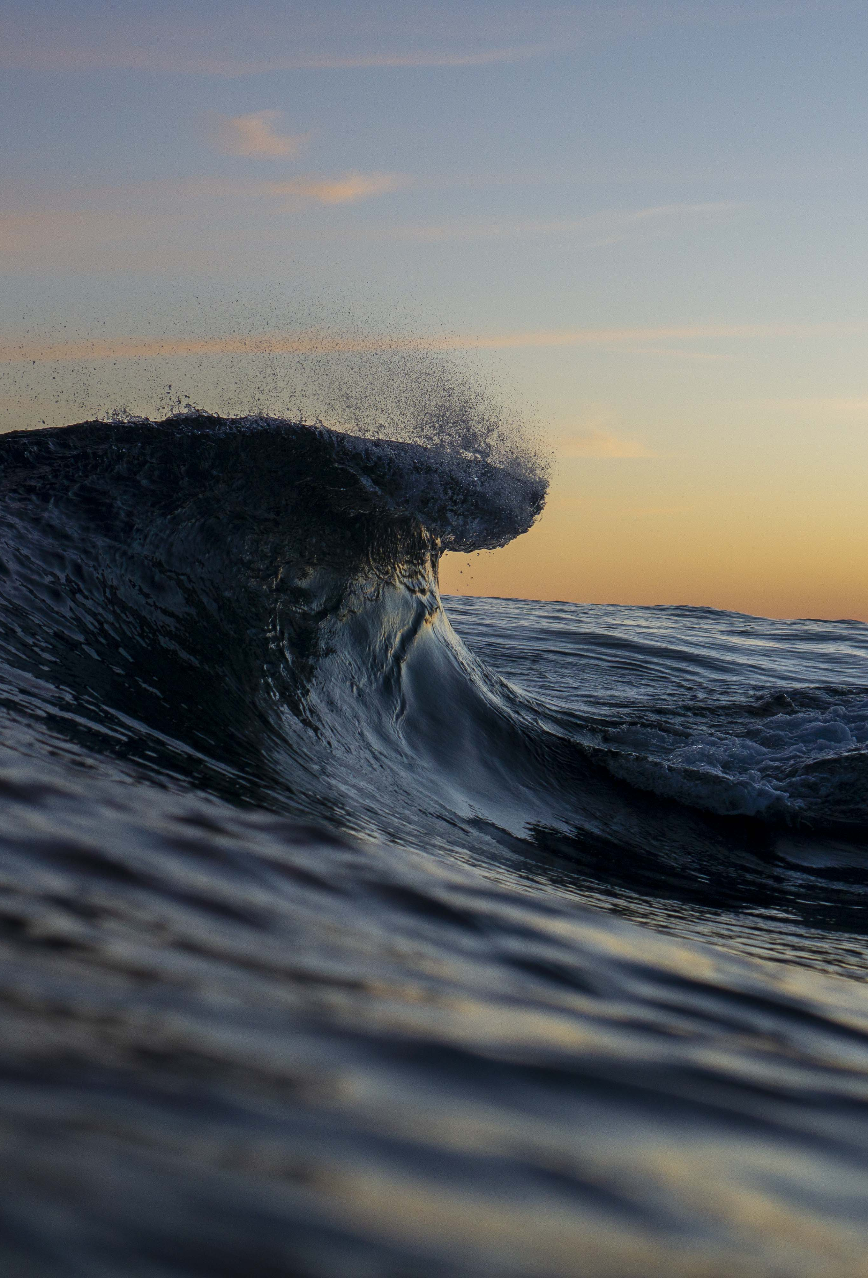
Projects
Coastal Zones Under Intensifying Human Activities and Changing Climate: A Regional Programme Integrating Science, Management and Society to Support Ocean Sustainability (Coastal-SOS)
Xiamen University - China
Urbanized coastal sustainability under GCC scenario
Instituto de Investigaciones Marinas y Costeras - IIMyC- (Universidad Nacional de Mar del Plata -UNMDP- and Consejo Nacional de Investigaciones Científicas y Técnicas -CONICET-) - Argentina

Slide 7

Actions 2021-2023
1 Session in Marine Litter Marlice Forum (ES)
1 Manifesto in the framework of the legally binding agreement about plastic UNEA 5.2 UN Ocean Conference Interactive dialogue 1 (PT)
1 Intervention at MobyLitter Polytechnic University of the Marches (IT)
1 Side event at the UN Ocean Conference
3 Sessions in Festivals of Barcelona Cities (ES)
1 The month of Ocean Cities (pilot at BCN in collaboration with the BCN local council)
1 Session in An Ocean of Values. The 5th Community Workshop of the IOC-UNESCO Ocean Best Practices System
Charter
I. Protect and restore marine and freshwater ecosystems and biodiversity, in line with the EU Biodiversity Strategy 2030
II. Prevent and eliminate pollution of our ocean, seas and waters, in line with the EU Action Plan Towards Zero Pollution for Air, Water and Soil
III. Make the sustainable blue economy carbon-neutral and circular, in line with the proposed European Climate Law and the holistic vision enshrined in the Sustainable Blue Economy Strategy
i. Digital Ocean and Water Knowledge System
ii. Public mobilisation and engagement

Slide 8
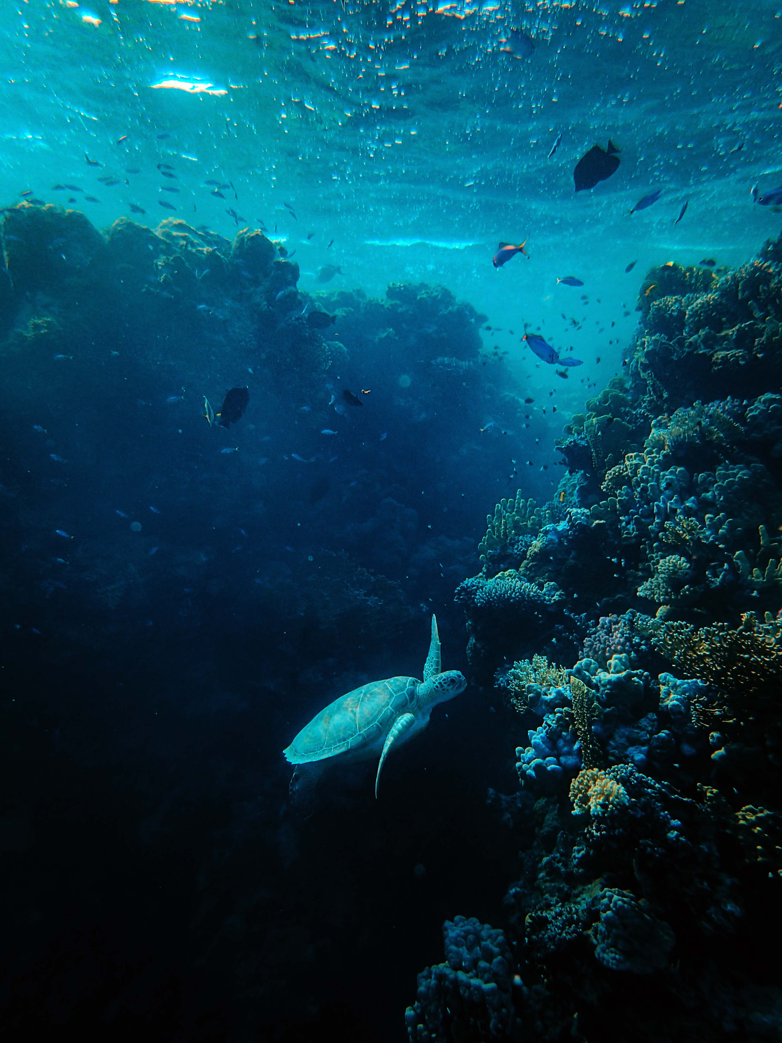
THANK YOU
vsalvo@icm.csic.es
https://ocean-cities.org
Integrated Coastal Management and Marine Spatial Planning in support of Coastal Resilience
UN Decade Collaborative Centre for Coastal Resilience - University of Bologna - Workshop – January 18, 2023

