Slide 1


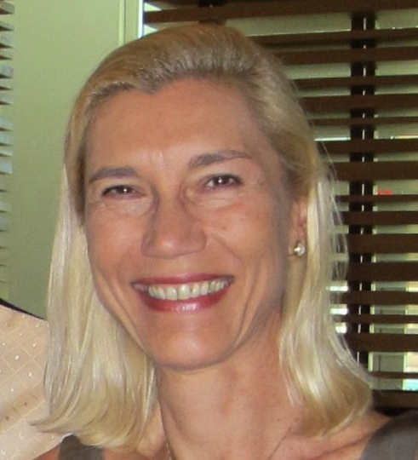



Coastal Resilience workshop
JANUARY 18, 2023
CoastPredict:
Observing and Predicting the Global Coastal Ocean
Villy Kourafalou
Professor of Ocean Sciences, University of Miami
Co-chair, CoastPredict
Co-chair, OceanPredict Coastal Ocean & Shelf Seas Task Team

Slide 2
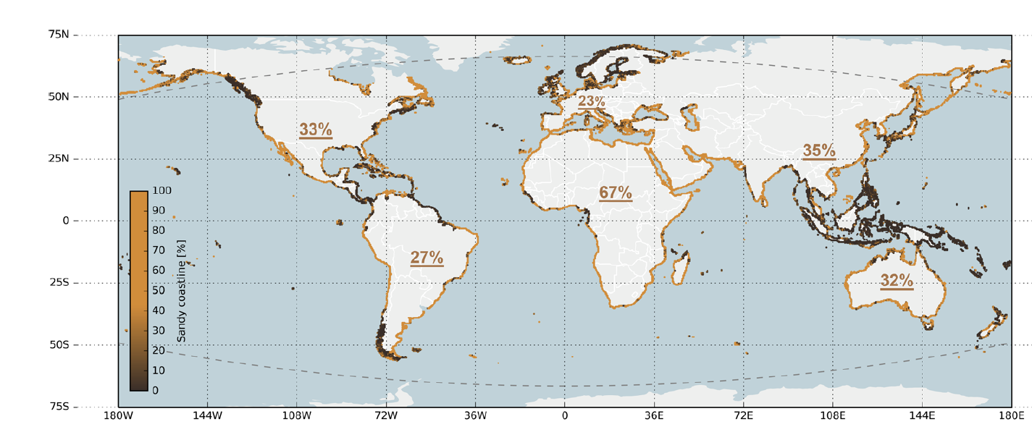
Outline
The concept of the Global Coastal Ocean
CoastPredict objectives and strategic planning
CoastPredict Solutions
International Collaborations
Sandy coastlines from optical satellite images since 1984
Arjen Luijendijk et al., Sc. Rep., 2018

Slide 3
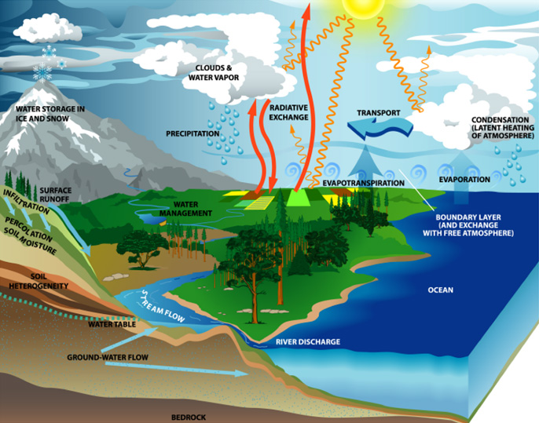
The concept of the Global Coastal Ocean
PRESENT NON-UNIFORM TERMINOLOGY
the coastal ocean, coastal zone, coastal margin, continental shelf, continental margin, shelf sea
NEED TO FIND A UNIFORM DEFINITION
THE COASTPREDICT STARTING POINT:
the coastal ocean - that area, extending inshore from the estuarine mouths to river catchment, to the urban settlements on the one side and on the other to the offshore, from the surf zone to the continental shelf and slope where waters of continental origins meet open ocean currents.
THE GLOBAL COASTAL OCEAN
(The Sea, Vol 10, 11, 12 14A and B)

Slide 4
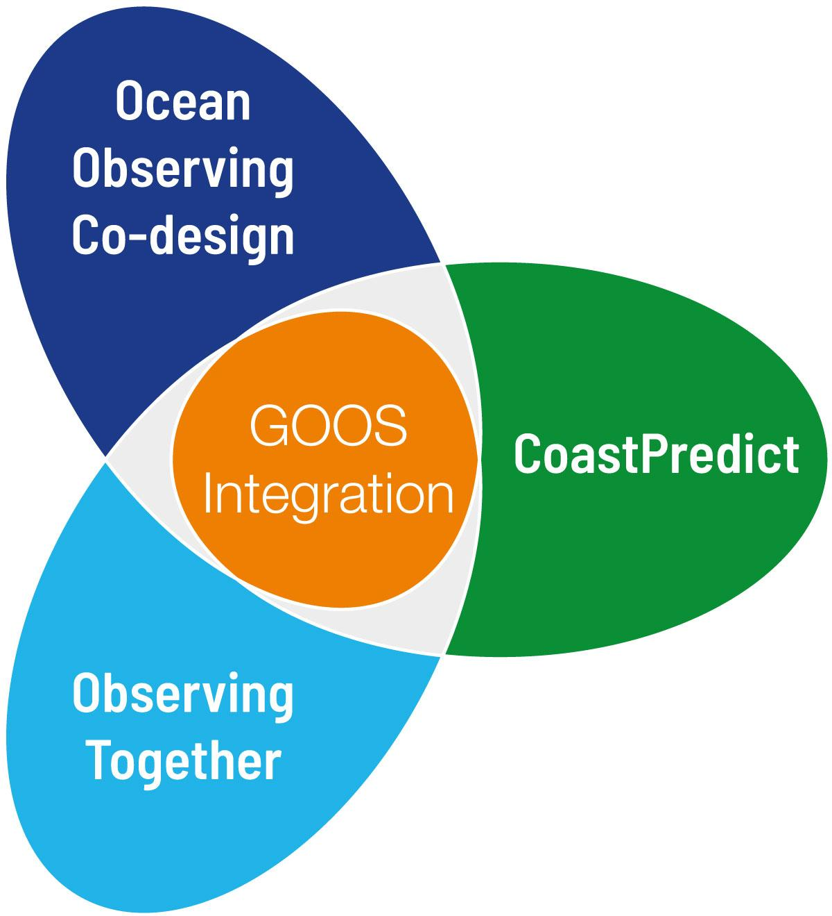
CoastPredict High level objectives
A predicted global coastal ocean;
The upgrade to a fit-for-purpose oceanographic information infrastructure;
Co-design and implementation of an integrated coastal ocean observing and forecasting system adhering to best practices and standards, designed as a global framework and implemented locally.

Slide 5
CoastPredict expected outcomes
1.
2.
3.
Integrated knowledge of global coastal ocean from events to climate.
Design and implementation of an integrated river / estuarine / coastal / open ocean observing and modelling multidisciplinary system.
Improved coastal marine forecasting and extended range predictive capabilities for the coastal ocean.
4.
5.
6.
Development of methods for trusted data / information exchange and interoperability across the value chain.
Innovative and sustainable
applications for coastal solutions/
services that directly benefit local populations including well-being and human health.
Increased equitable education and capacity for observing and forecasting in the global coastal ocean.

Slide 6
CoastPredict strategic planning and groups
Focus Area 1
Integrated observing and modelling for short term coastal forecasting and early warnings
Focus Area 4
Coastal ocean and human health
10 world ocean areas
where
CORE projects
will be developed
Focus Area 2
Earth system observing and modelling for coastal climate monitoring and downscaling
Focus Area 5
International open and free access to coastal information
Focus Area 3
Solutions for integrated coastal management
Focus Area 6
Equitable coastal ocean capacity
3 Core projects and 4 affiliated projects already endorsed that plan the strategy for each focus area

Slide 7
The challenge: expand operational oceanography to the global coastal ocean
The CoastPredict solutions:
use of new technologies with best practices
LARGE SCALE
COASTAL SCALE
HF RADAR
HR SATELLITE
AERIAL SURVEYS/DRONES
TIDE GAUGES
REPEATED MULTIPARAMETRIC SECTIONS
COASTAL RADARS
CITIZEN SCIENCE MONITORING
●AUTONOMOUS UNDERWATER
VEHICLES
CABLED MULTIPARAMETRIC STATIONS
● RIVER RUNOFF AND LOADING
MONITORING
SEDIMENT/WQ MONITORING
● MOORED BUOY ARRAYS
● SOOP EXPANDABLE
SATELLITE SENSING:
SEA LEVEL,
SEA SURFACE
TEMPERATURE,
SEA SURFACE SALINITY,
COLOR, WINDS
● DRIFTING BUOYS
(SURFACE AND SUBSURFACE)
● GLIDERS
Real time with
international
standards,
open and
free data, relocatable sensors and sampling
OBSERVING
SYSTEM
MODEL PHYSICS
PRIMITIVE EQUATION (> 1-5 KM)
TURB.PARAM.
MODEL PHYSICS
PRIMITIVE EQUATION (<1- 5 KM)
● TURBULENCE AND LIGHT
SUBMODELS
RIVER CATCHMENT
AND ESTUARIES
Short term
predictions
and climate
coastal
downscaling
DATA ASSIMILATION
OPTIMAL INTERPOLATION
3-DVAR, KALMAN FILTER
DATA ASSIMILATION
● KALMAN FILTERS
● ADJOINT MODELS
BIOCHEMICAL MODELS
● PELAGIC COMPARTMENT
● BENTHIC CLOSURE
PREDICTING
SYSTEM
BIOCHEMICAL MODELS
● PELAGIC COMPARTMENT
● BENTHIC-PELAGIC COUPLING
● SEDIMENT DYNAMICS
ATMOSPHERIC FORCING
OPERATIONAL ANALYSES AND FORECASTS FROM GLOBAL SCALE MODELS
ATMOSPHERIC FORCING
OPERATIONAL ANALYSES AND FORECASTS FROM LIMITED AREA MODELS
Notes:
CoastPredict is going to develop both observing and modelling for predictions considering the experience at the large scale. For the Coastal scale CoastPredict is going to start new networks with emerging technologies, developing the international standards and develop new modelling to consider the emerging definition of the global coastal ocean and the need of calibrated/validated coastal models

Slide 8
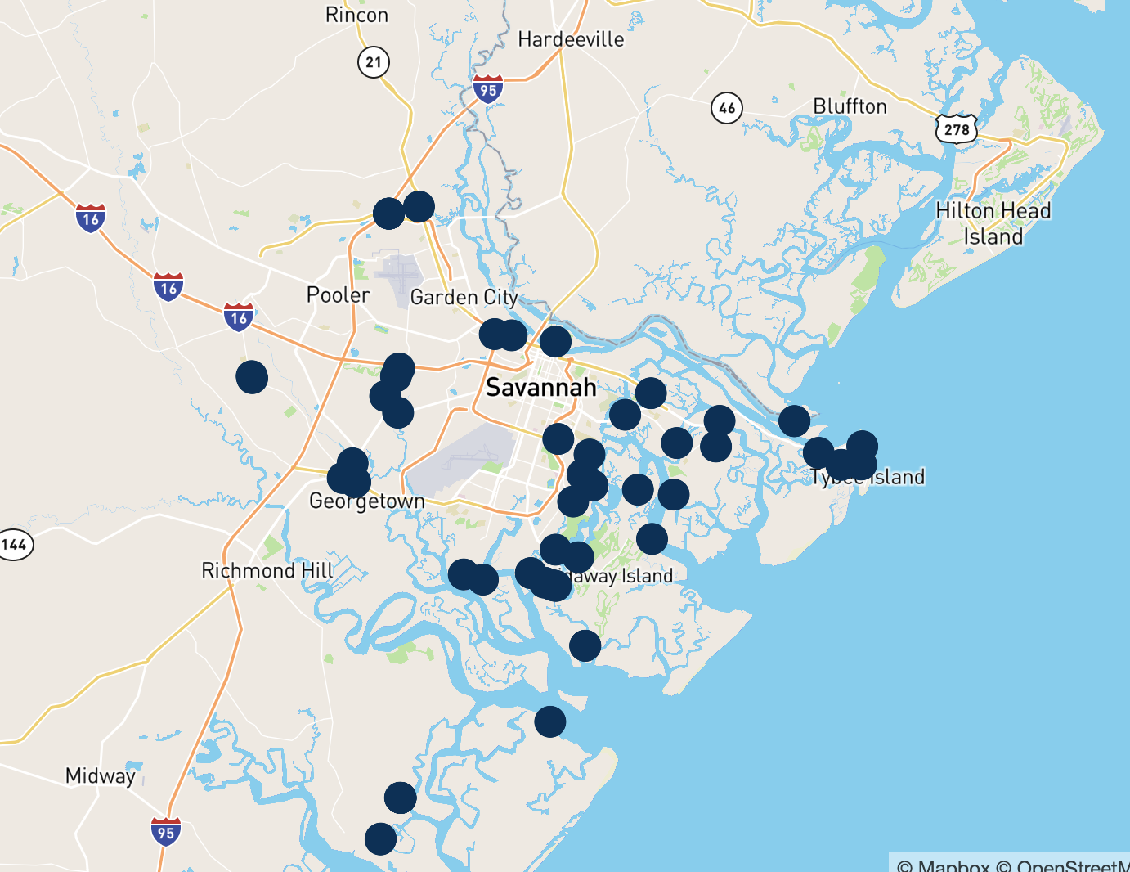
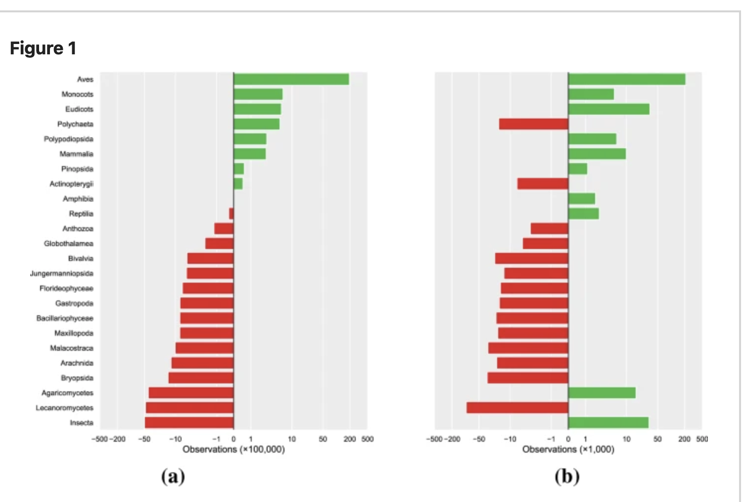

The CoastPredict solutions: transform the OBSERVING
Example: Internet sea level low-cost
Sensors (USA)
Example: the Species Observation System
for taxa recognition (Norway)
Species recognized visually
Species recognized by
image processing
Koch, W.,et al.Sci Rep 12, 7648 (2022)

Slide 9
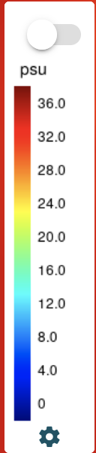
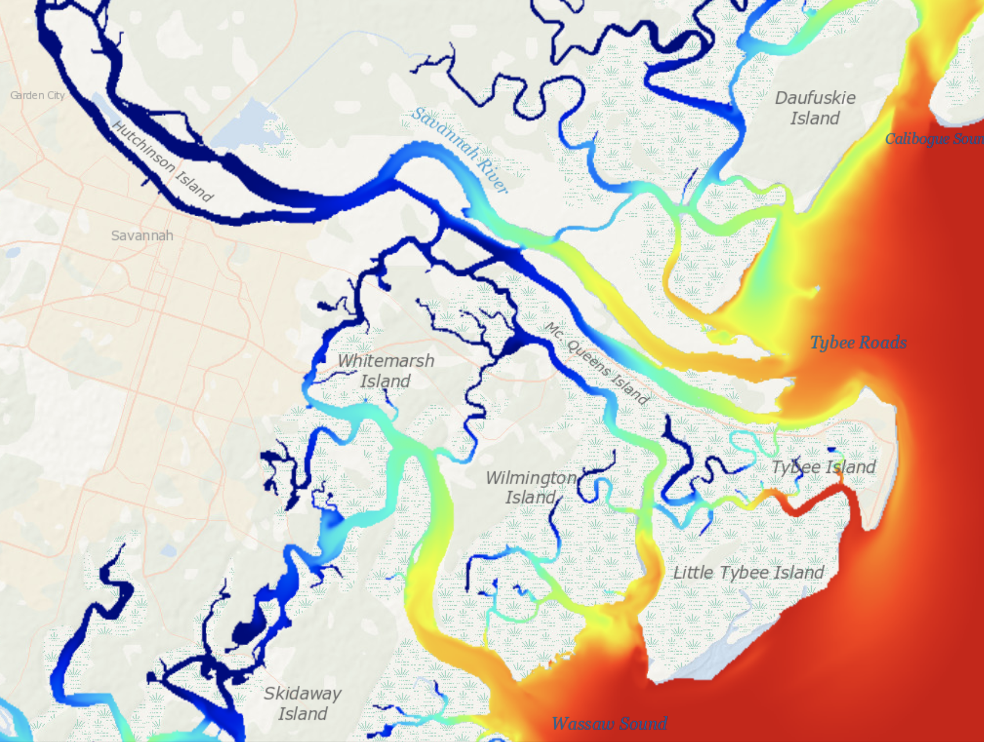

The CoastPredict solutions: transform the MODELLING
Every day a seamless forecast of sea level and salt wedge
in the estuaries and the coastal zone. Operational: https://savannah.cmcc.it/
Salinity on June 19 2022
Notes:
CoastPredict will revolutionize the coastal modelling by downscaling the open ocean free information at the urban scale to forecast important environmental conditions such as salt intrusion from estuaries. Here you see such a forecasting system showing the red-salty waters entering the river and the wetlands.

Slide 10
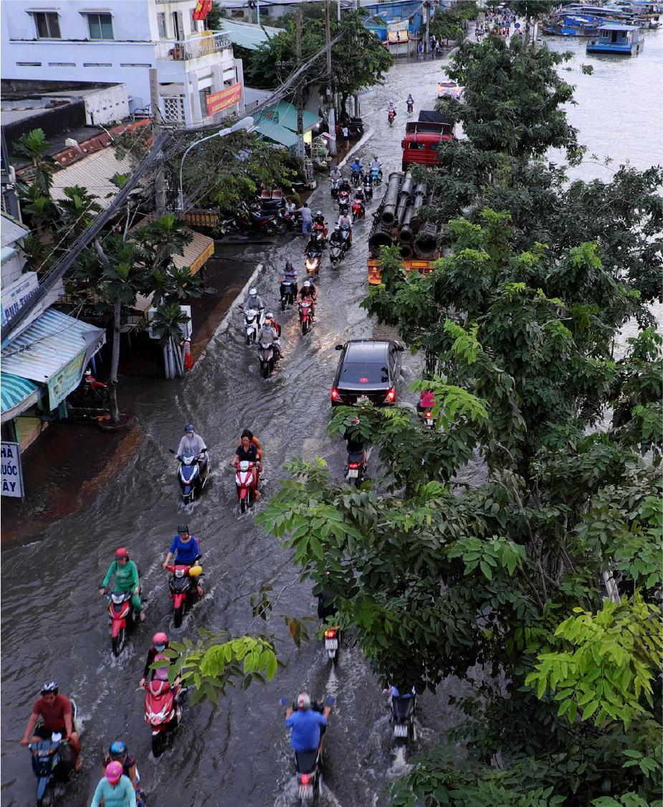
CoastPredict will:
Transform the science of observing and predicting the Global Coastal Ocean;
Develop an integrated coastal and open ocean observing and modelling system;
Provide improved, multidisciplinary, and extended range coastal predictive capability to respond to societal needs;
Upgrade the infrastructure for exchange of data with standard protocols.

Slide 11
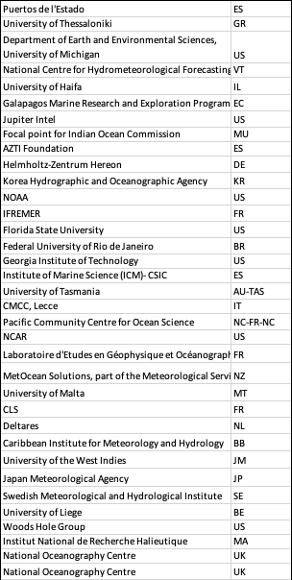
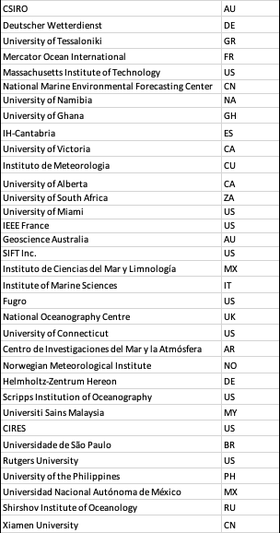
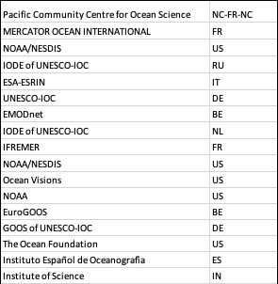
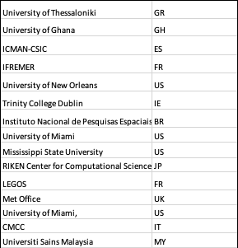
WHO WE ARE …
STEERING COMMITTEE
ADVISORY COMMITTEE
ECOP
www.coastpredict.org
info@coastpredict.org

Slide 12
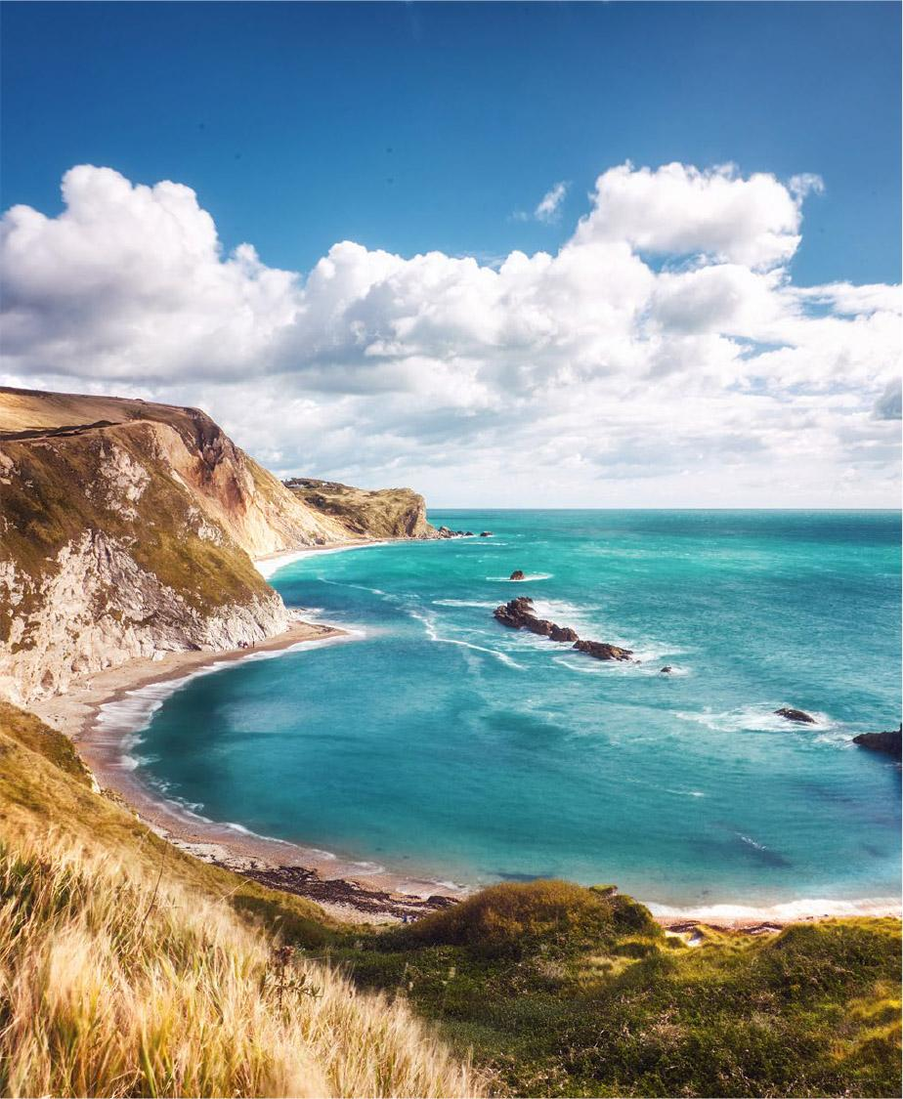
Collaborations
CoastPredict will make vital, real and
lasting change.
CoastPredict welcomes collaborations, pledging to work inclusively to achieve the Programme’s mission and goals.
www.coastpredict.org
info@coastpredict.org

