Slide 1
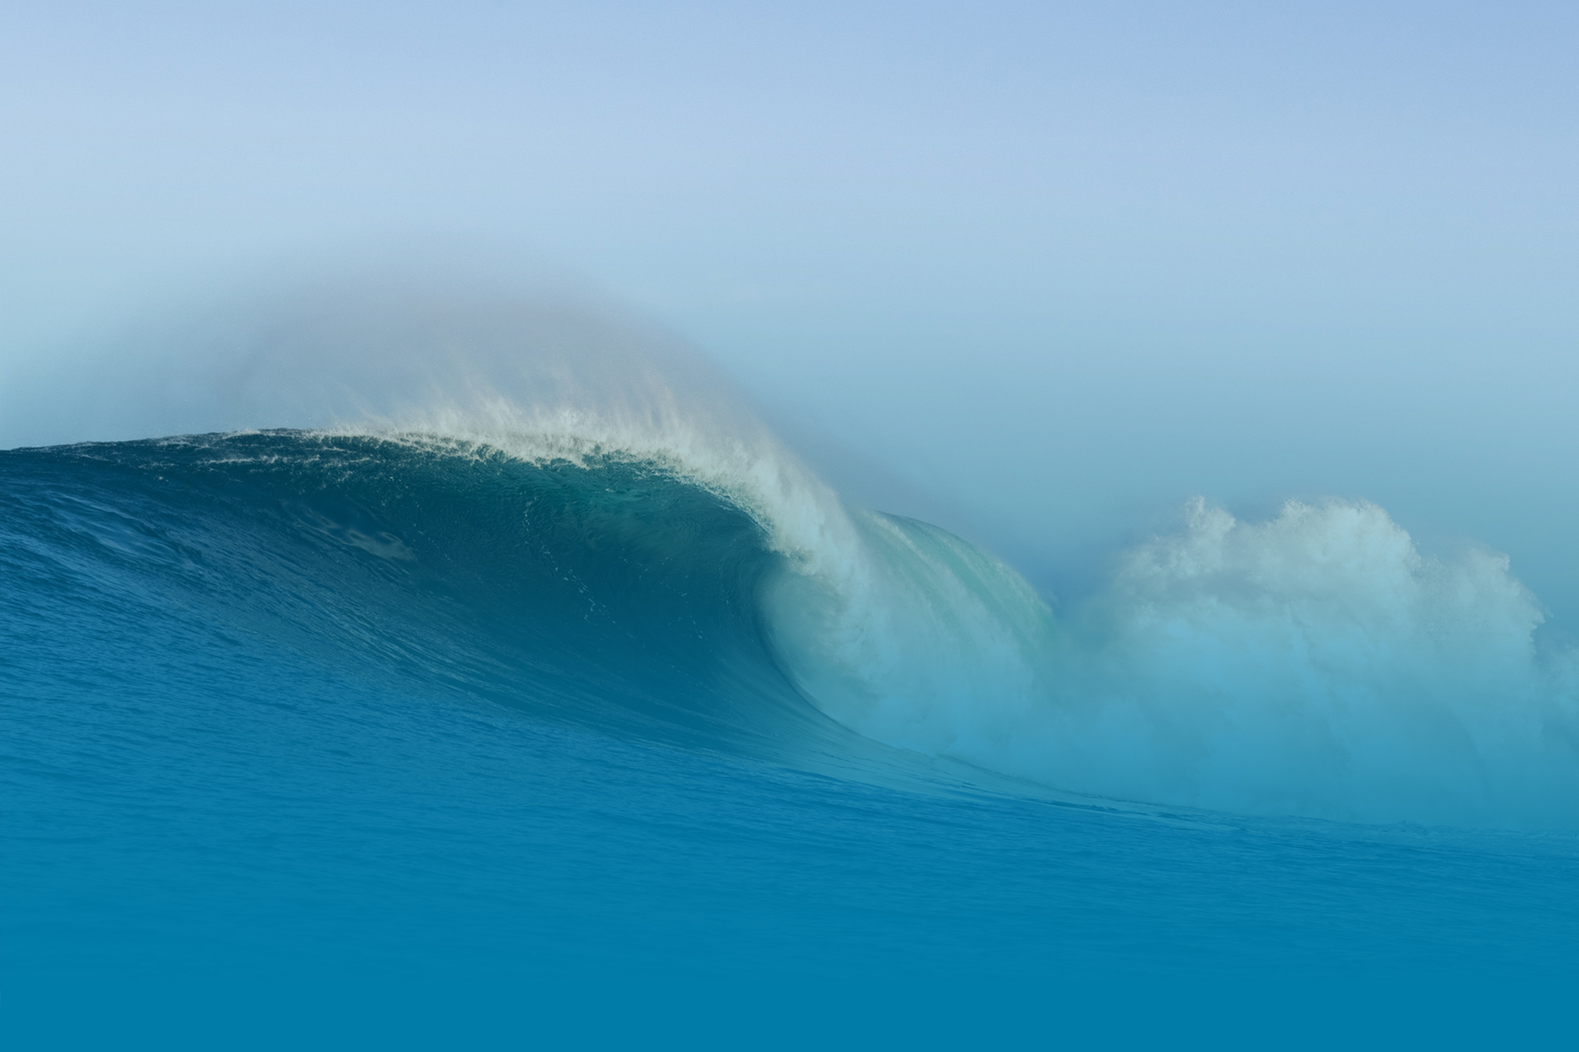
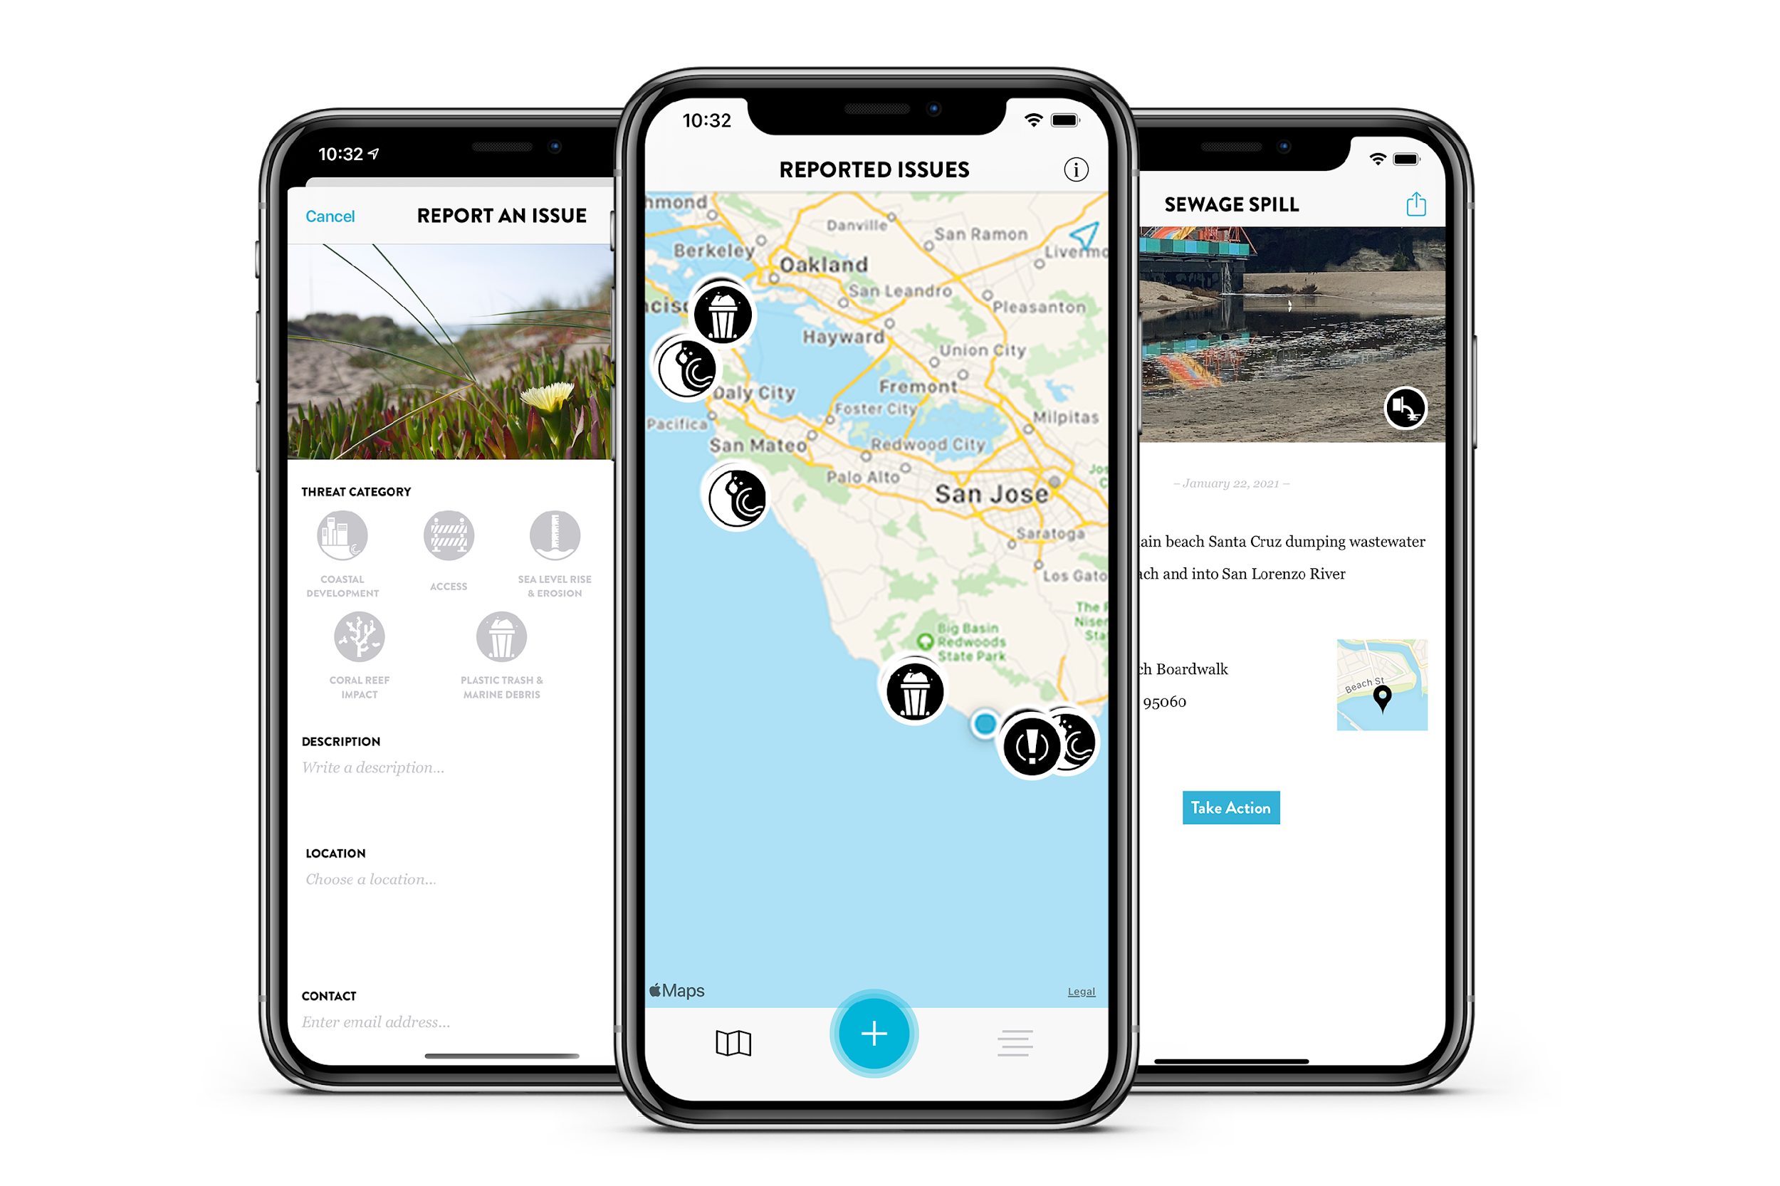
THE SAVE THE WAVES APP:
A COASTAL COMMUNITY MONITORING TOOL
Notes:
Diego intro: co-chair of the session and I am the Data Coordinator at Save The Waves Coalition and project lead for the Save The Waves App.
Honored to be here talking about our coastal community monitoring tool, The STW App, in the context of coastal community empowerment through technology to tackle marine debris.

Slide 2
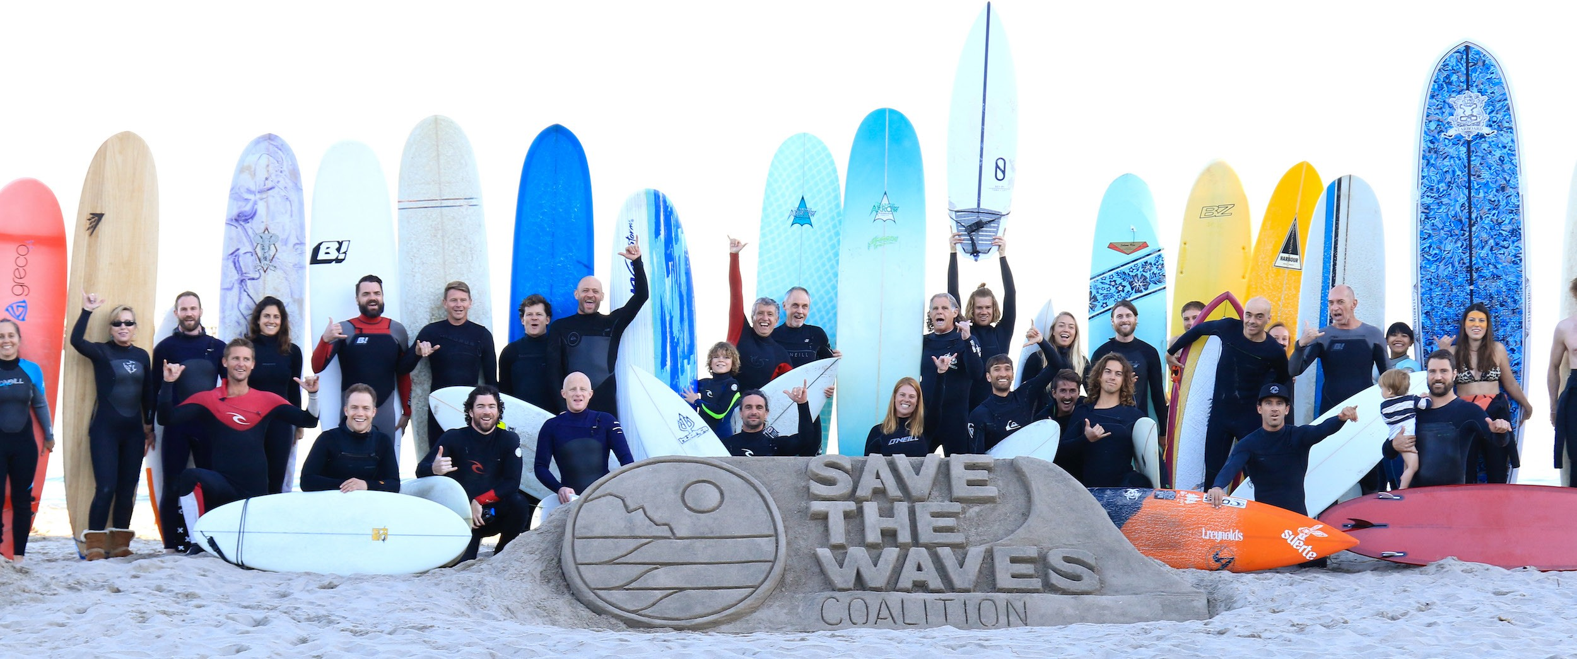
WHO WE ARE.
Save The Waves Coalition (STW) is an international nonprofit that works with diverse organizations dedicated to protecting surf ecosystems.
Notes:
STW is an int’l non profit that works alongside communities and organizations around the world to protect surf ecosystems.
A surf ecosystem is the combination of three factors: the geophysical conditions that make an amazing, unique breaking wave for surfing, the really important habitat for biodiversity provided by these coastal zones, and the human well-being associated with surfing and spending time in the ocean.

Slide 3
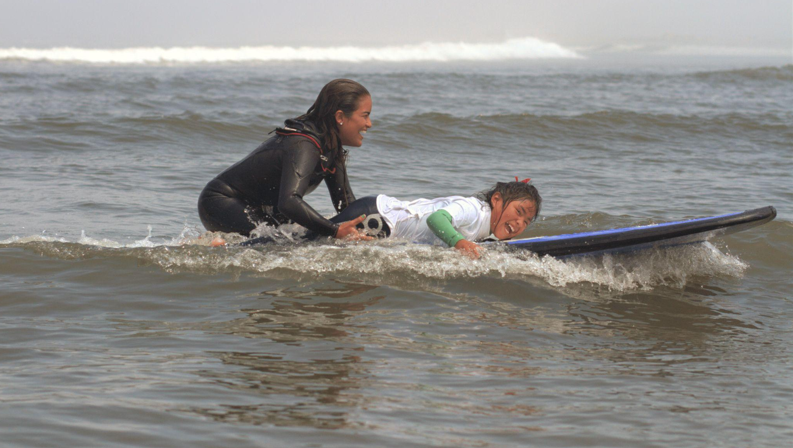
Why surfing?
Why surfing?
Credit: AFP
Notes:
Why do we focus on surfing? A picture is worth a thousand words. The ocean provides livelihoods across the world, but beyond that it’s also a source of joy and well-being, like in this image, and that is really at the heart of why we’re using surfing as the platform and approach to conservation. Surfing is also a sport practiced by over 35 million people worldwide in over 40 countries, with a collective impact of about $60 billion annually in terms of tourism revenue—-. So we think that this can be a powerful constituency for marine conservation and the reduction of land-based pollution. When a surfer experiences their waves covered in trash or gets sick from poor water quality, those impacts are real, so we work to mobilize surfers around the world to protect the surf ecosystems that they love.

Slide 4
THE SAVE THE WAVES APP
Notes:
So, the Save The Waves App, what I’m here to talk about today, is one of the main tools we use to empower individuals to engage with the issues their communities face. By harnessing the network of the 35M+ surfers in the world, we’ve created a really easy platform for those who are so motivated to take care and steward of these places easily. Surfers also frequent some of the most difficult to access places in the world searching for waves, and most of them carry a phone in their pocket at all times, so combining this simple data collection with the incentive of wanting to protect these places, we get a dedicated stakeholder group of citizen scientist for documenting and responding to threats around coastal issues.
While there are quite a few apps to report specifically trash the STW App is more of a coastal alert and monitoring system. The App identifies the issue before any action is taken and mobilizes individuals or partner organizations to address it. To successfully achieve this, we focus heavily on accessibility and simplifying the steps to make a report, as well as making data flows seamless and fast. So we've made the App available in 4 languages (eng,span,port,french), built it both for Apple ios and android operating systems, and a report takes under 1 min to be completed and our partners can receive real-time alerts of reports in their area.

Slide 5
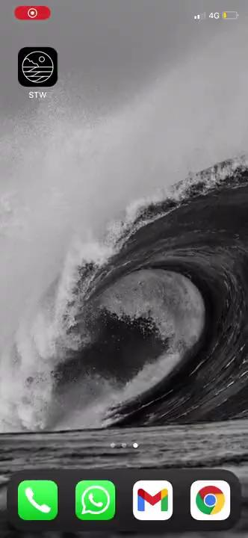

Slide 6
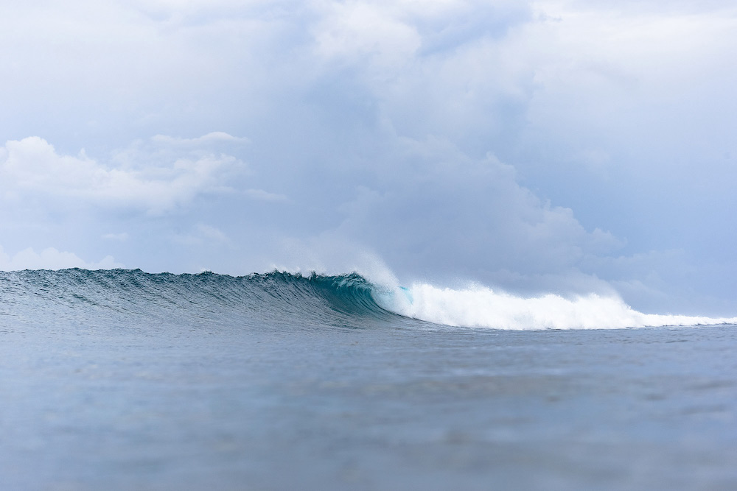
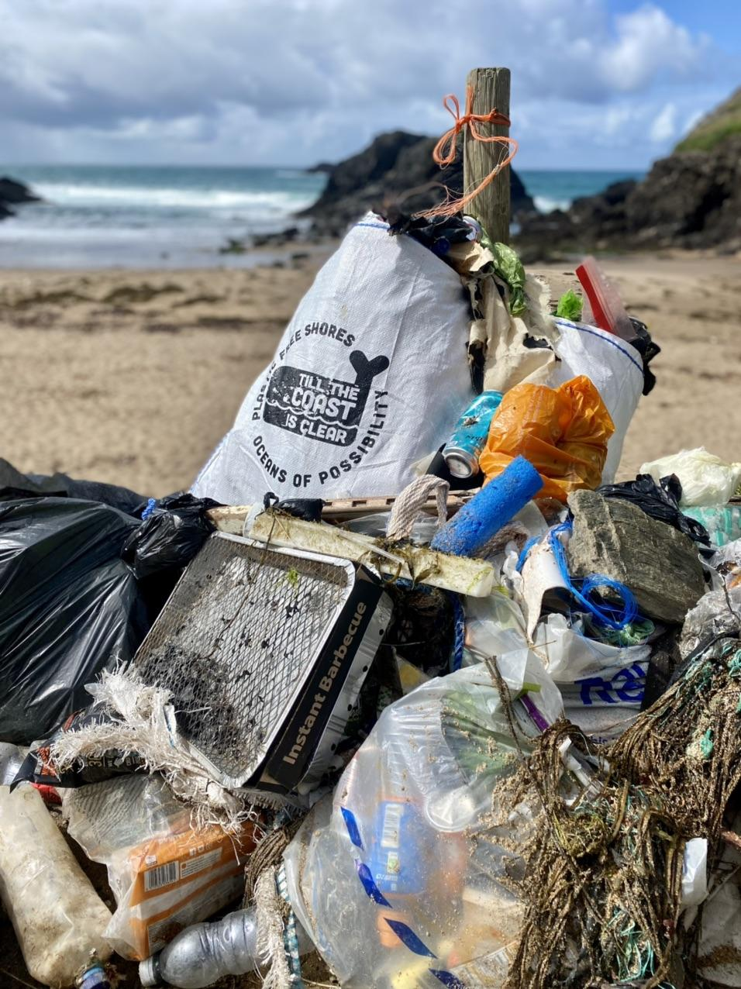
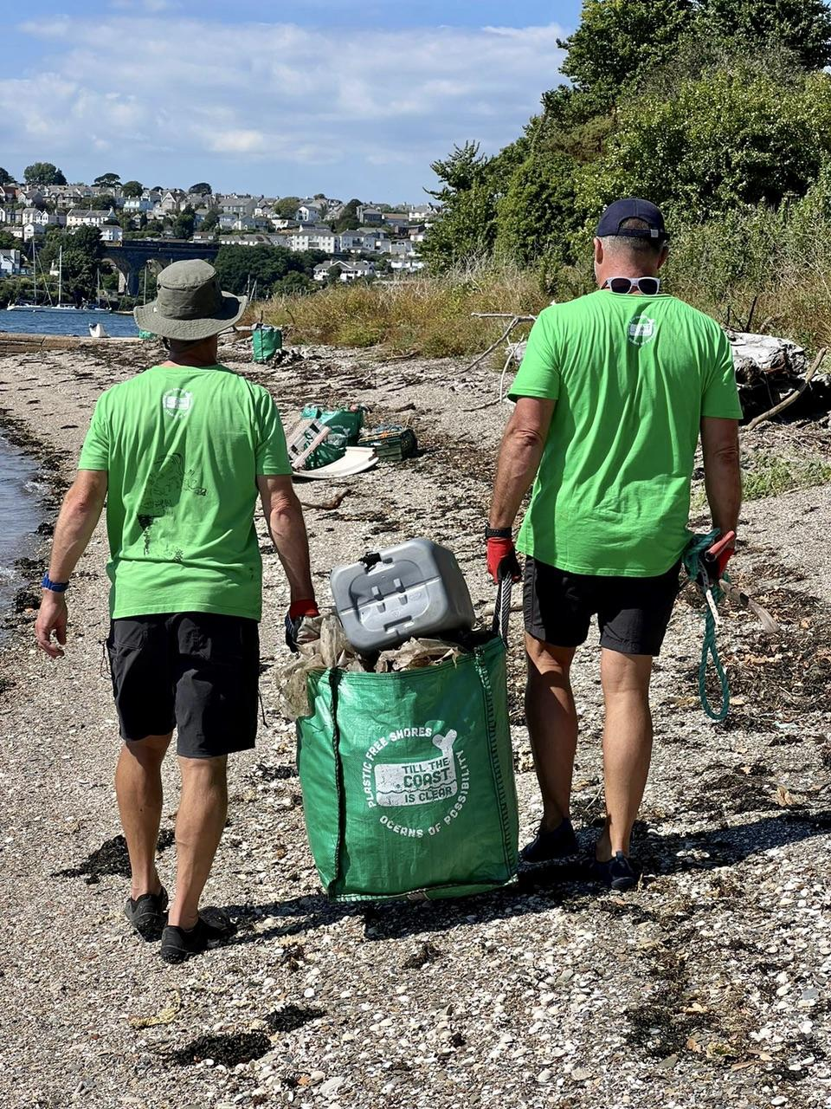
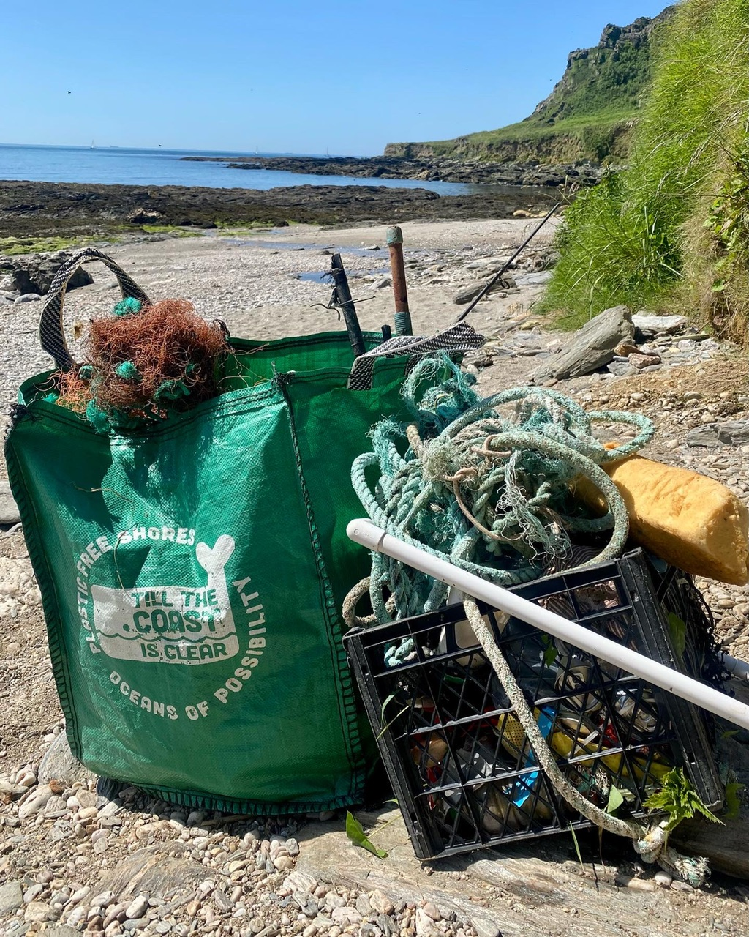
APP PARTNERSHIPS
Notes:
our partners on the ground help us respond to reports all around the world
from cleaning up hard to access places, like in this image, to advocating for cleaner waters, better sea level rise adaptation strategies and reducing climate vulnerabilities, our partners make app reports actionable
we are constantly building new partnerships and alliances to collaborate and make this app a more valuable resources for individuals, organizations and communities

Slide 7
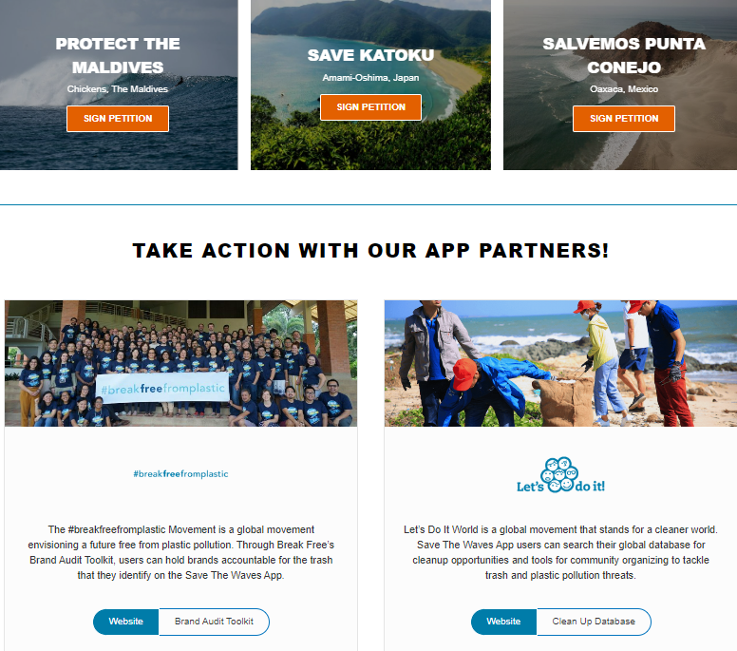
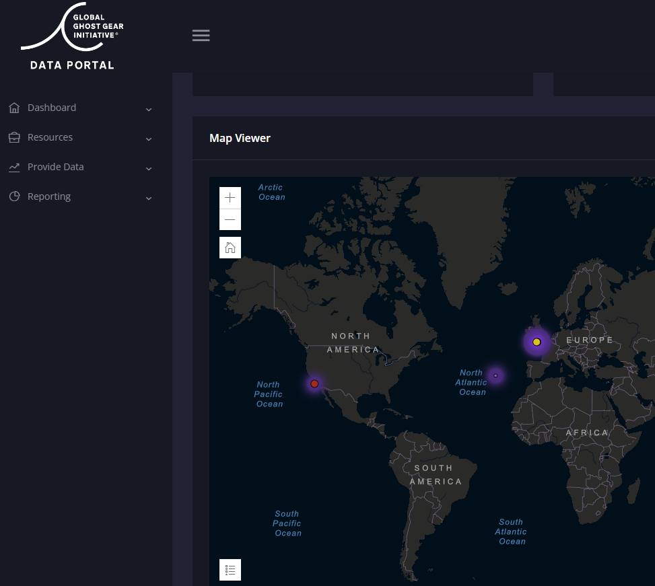
APP PARTNERSHIPS
Notes:
The App’s Take Action option links users and partners with existing resources that they can follow to take their impact one step further, such as conducting a brand audit at their next cleanup, or signing up for a cleanup event, to name a few. We strive to continue building this resource library so that we can activate more of our user base through impactful initiatives.
Similarly, we try to share our data with as many initiatives as possible, such as the GGGI or the international waste platform’s database. The data is open access on our website, but we also work proactively to find new initiatives where it can be helpful.

Slide 8
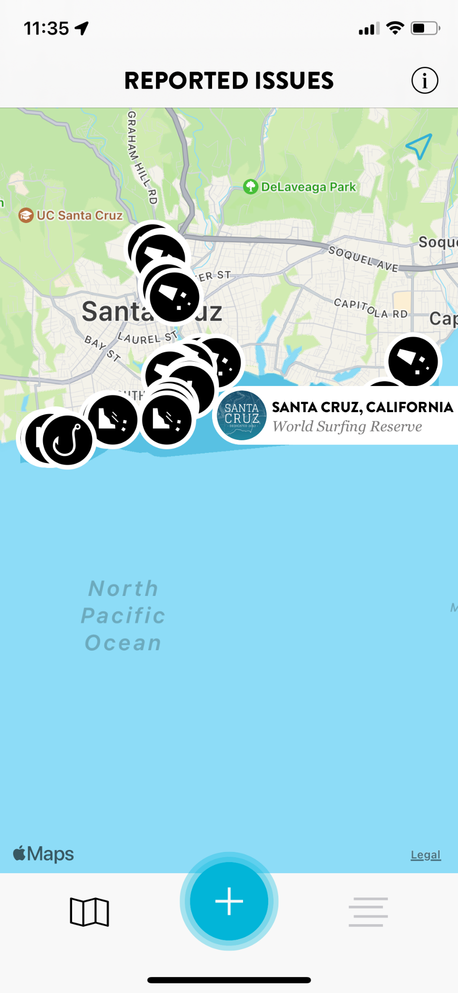
APP PARTNERSHIPS
Notes:
Lastly, our strongest connection with communities is found through our conservation programs at STW, namely the World Surfing Reserves and Surfing Protected Area Networks programs. The World Surfing Reserves program is STW’s flagship program proactively identifies, designates and preserves outstanding waves, surf zones and their surrounding environments around the world. WSRs represent a global network of designated surfing reserves that are managed, implemented, and protected by local communities. Surf Protected Area Networks were developed as a response to the added demand to protect waves in coastal communities once a WSR is designated, and follow a 6 steps process where we engage communities and work together to advocate and designate protected areas.
For both of these programs, we work closely with local groups and protected area managers in the outreach stage to position the STW App as a tool for everyday surfers and beach goers to support the protected area or WSR’s mission of protecting their coast. We also work with them to respond to some of these issues and create campaigns to map threats in specific areas, as well as monitor the most pressing environmental issues to their communities.
This image here shows the Santa Cruz WSR in California. In this WSR, we’ve successfully mapped trash along the San Lorenzo river leading to continuous campaigns from local groups alongside the WSR to remove accumulated trash before every winter season starts – reducing the amount of debris that reaches the ocean. We’ve also mapped other coastal threats, like coastal erosion, and shared these maps with the City of Santa Cruz to aid in the coastal resilience planning process. We have 2 other WSRs in the NE Pacific where our partnerships are strong, which are in Bahia de Todos Santos, in Ensenada, Mexico, and in Malibu in California.
We are also using the App as a tool to identify threats that can be addressed by the WSR stewardship fund, which provides WSRs with resources to tackle some of these issues as per their local stewardship plans. After the fact, we will be using the App to monitor the impact that the project had in reducing the initial threat.

Slide 9
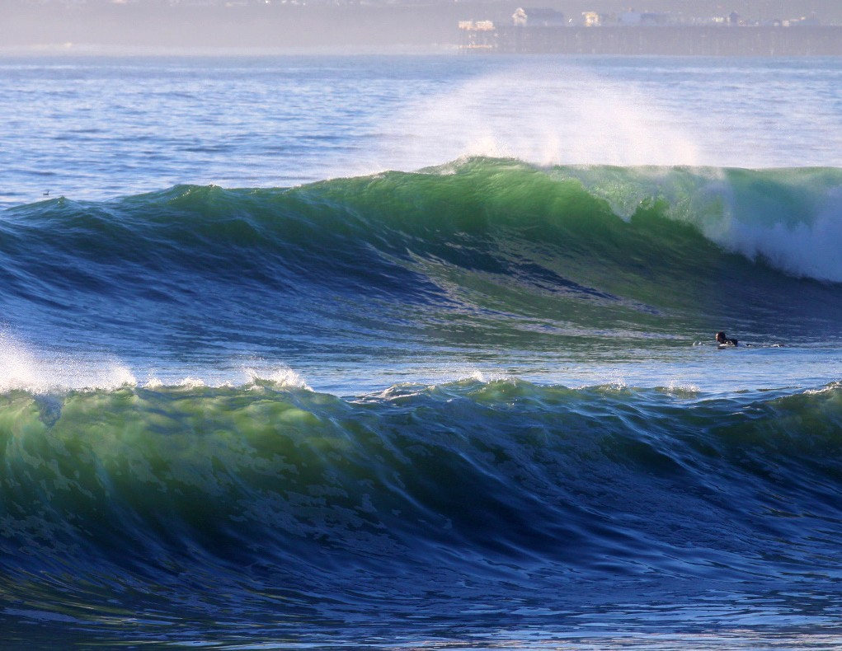
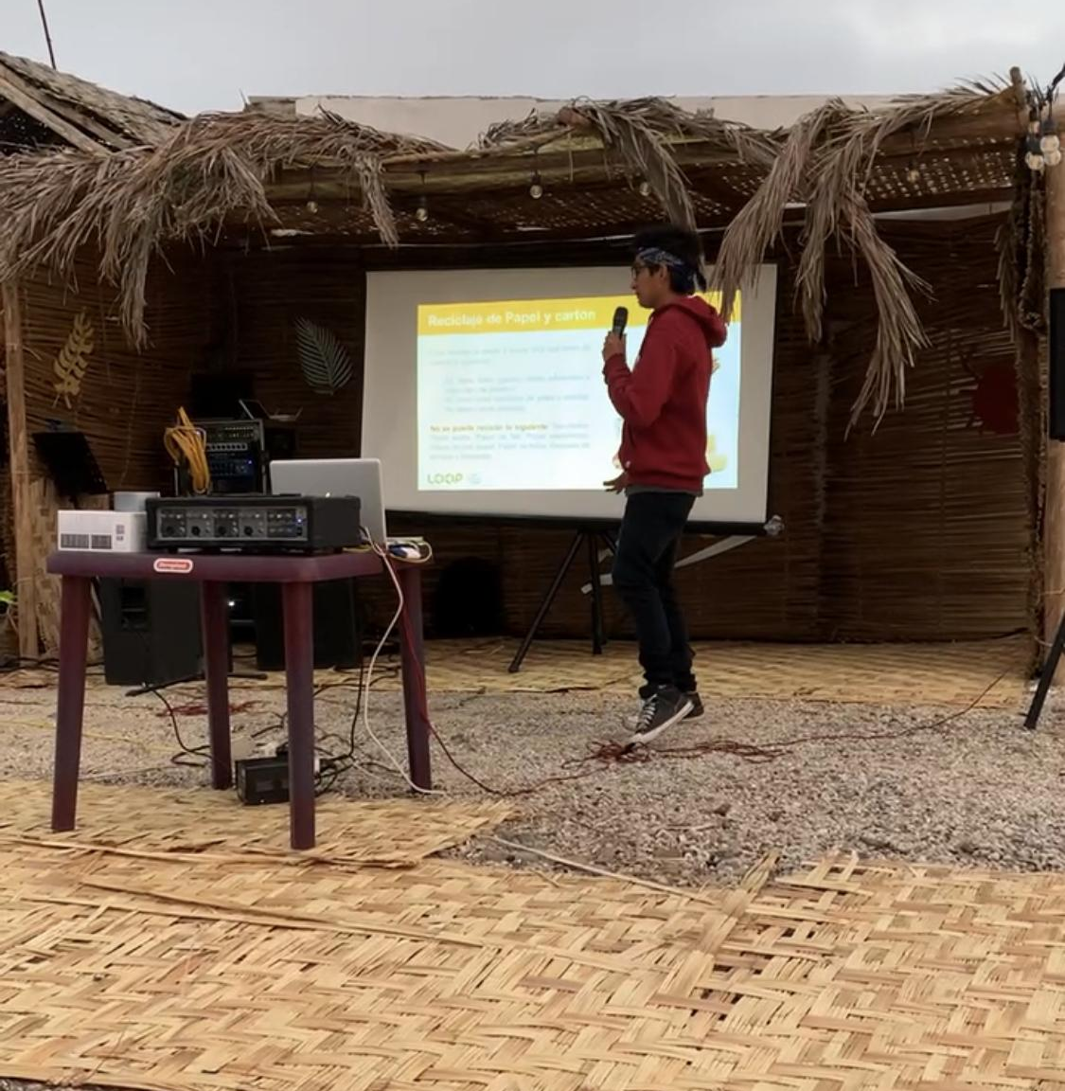
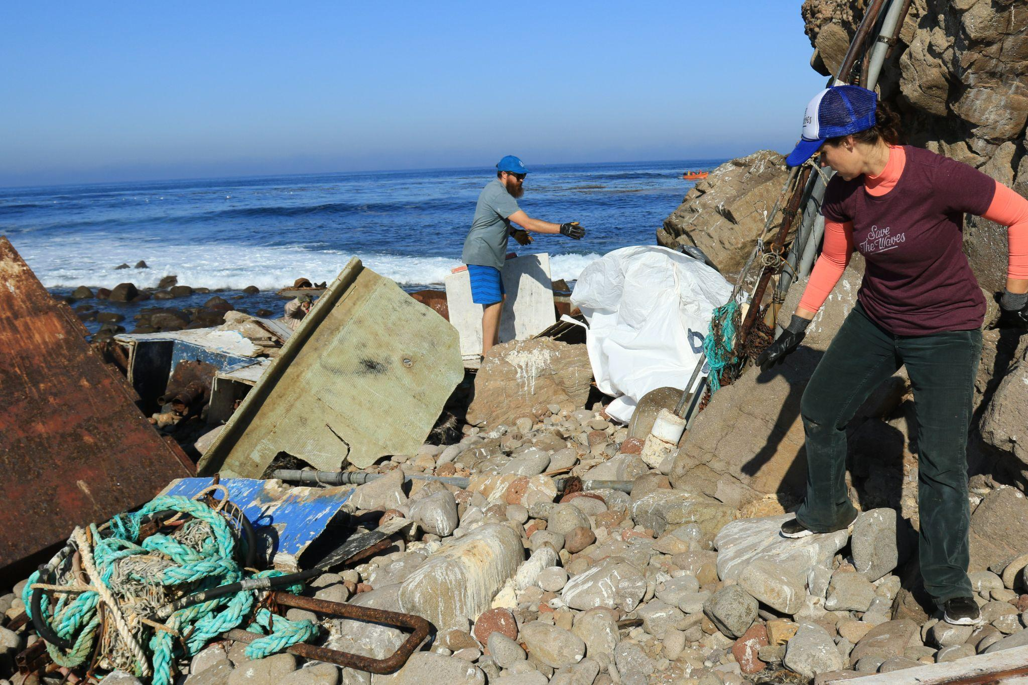
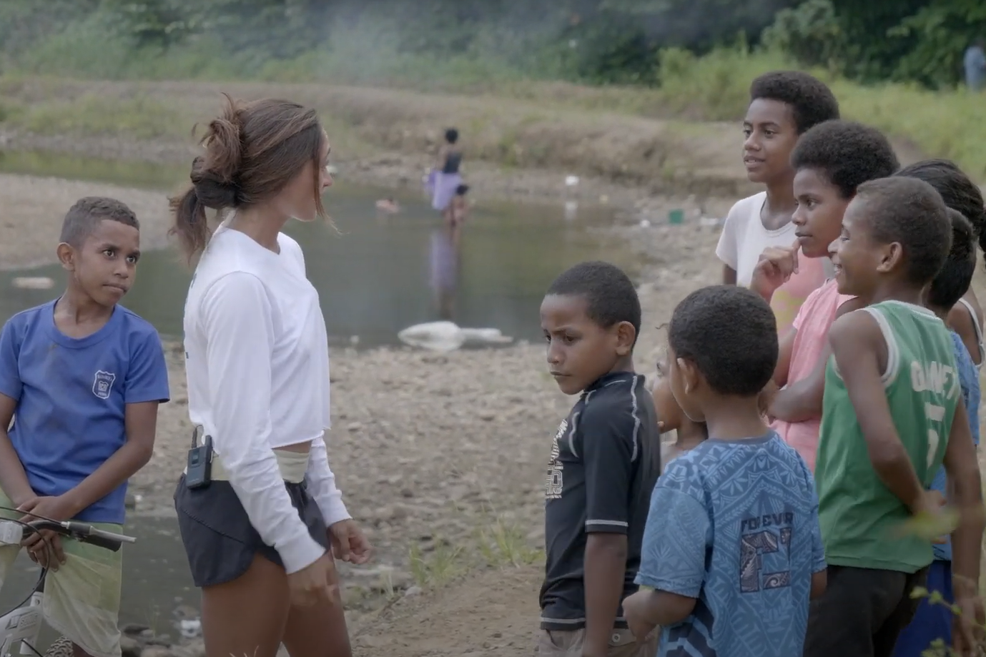
NEXT STEPS
Notes:
The STW App’s next steps are charted by our successes thus far. We have carried out stewardship projects in Mexico, Peru and Fiji, working closely with community members who reported an issue on the app, to clean up remote islands, educated both youth and adults on the environment, and supported basic waste management infrastructure.
Our next steps focus on creating more partnerships to respond and maximize the app’s impact, as well as creating a platform where stewardship projects can be funded directly and the app can be the connection between boots on the ground and concerned coastal users. We want to empower local leaders and their communities to do the work they want to do, and leverage this technology to do so. We are currently piloting this fund in World Surfing Reserves, where the App is a central point to identifying and monitoring issues they face, and in helping us design solutions that will tackle the root cause of pollution (or whatever issue they are addressing) in the long term.

Slide 10
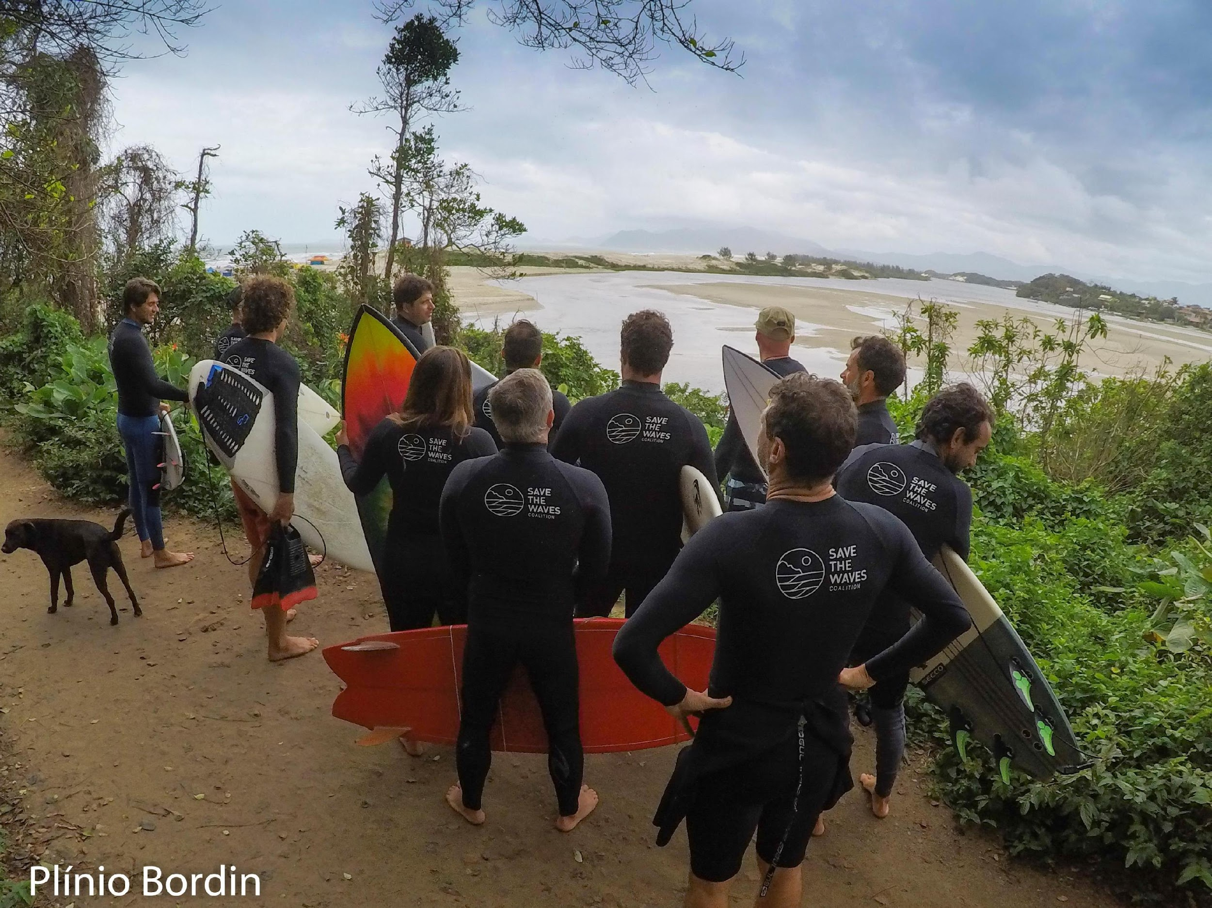
It Takes A Coalition.
Notes:
The takeaway from this talk is that it takes a coalition. Not only do we need all hands on deck to keep eyes on our coasts at all times and monitor threats that appear, but we need to collaborate between all the coastal conservationists and practitioners out there, as working together maximizes the impact we can have and helps us optimize our processes and the resulting solutions.

Slide 11
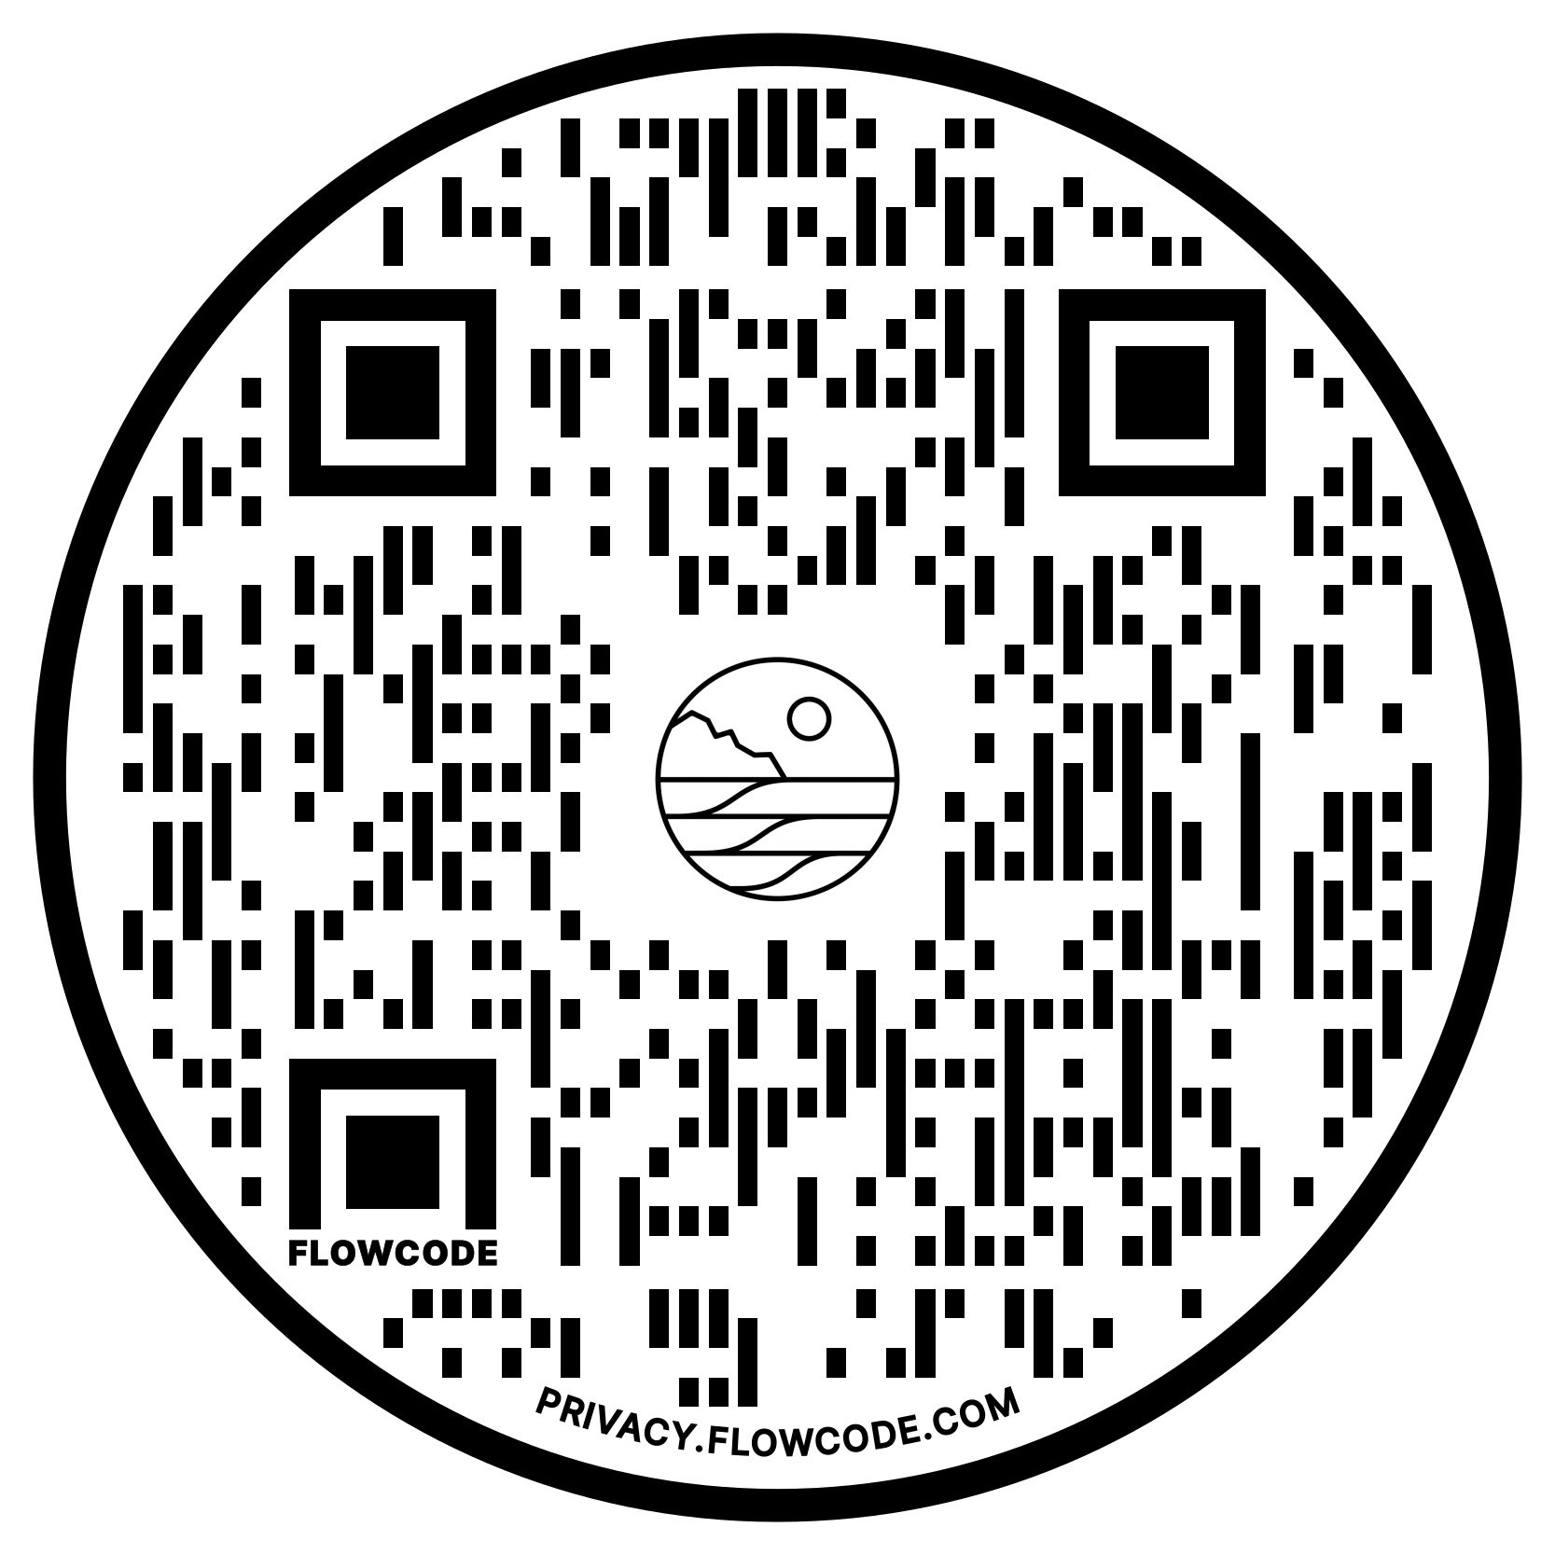
It Takes A Coalition.
DOWNLOAD THE APP
www.savethewaves.org/app
Notes:
So please download the app, play around with it, report threats from all over, and if you or your organization is interested in partnering with us please let me know.
Thanks for listening, any questions?

Slide 12
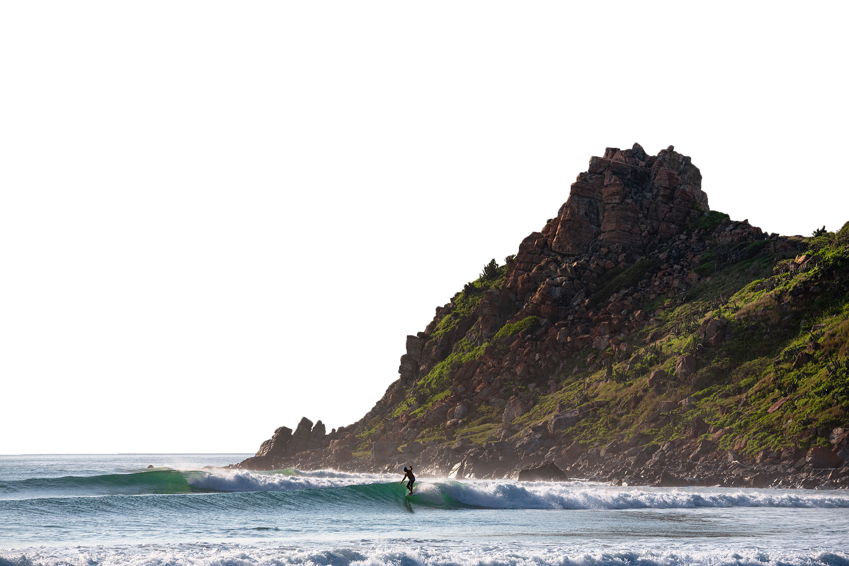
QUESTIONS & COMMENTS

